Slide 1
Link Layer
5.1 Introduction and services
5.2 Error detection and correction
5.3Multiple access protocols
5.4 Link-Layer Addressing
5.5 Ethernet
5.6 Hubs and switches
5.7 PPP
5.8 Link Virtualization: ATM

Slide 2
Point to Point Data Link Control
one sender, one receiver, one link: easier than broadcast link:
no Media Access Control
no need for explicit MAC addressing
e.g., dialup link, ISDN line
popular point-to-point DLC protocols:
PPP (point-to-point protocol)
HDLC: High level data link control (Data link used to be considered “high layer” in protocol stack!

Slide 3
PPP Design Requirements [RFC 1557]
packet framing: encapsulation of network-layer datagram in data link frame
carry network layer data of any network layer protocol (not just IP) at same time
ability to demultiplex upwards
bit transparency: must carry any bit pattern in the data field
error detection (no correction)
connection liveness: detect, signal link failure to network layer
network layer address negotiation: endpoint can learn/configure each other’s network address

Slide 4
PPP non-requirements
no error correction/recovery
no flow control
out of order delivery OK
no need to support multipoint links (e.g., polling)
Error recovery, flow control, data re-ordering
all relegated to higher layers!

Slide 5
PPP Data Frame
Flag: delimiter (framing)
Address: does nothing (only one option)
Control: does nothing; in the future possible multiple control fields
Protocol: upper layer protocol to which frame delivered (eg, PPP-LCP, IP, IPCP, etc)

Slide 6
PPP Data Frame
info: upper layer data being carried
check: cyclic redundancy check for error detection

Slide 7
Byte Stuffing
“data transparency” requirement: data field must be allowed to include flag pattern <01111110>
Q: is received <01111110> data or flag?
Sender: adds (“stuffs”) extra < 01111110> byte after each < 01111110> data byte
Receiver:
two 01111110 bytes in a row: discard first byte, continue data reception
single 01111110: flag byte

Slide 8
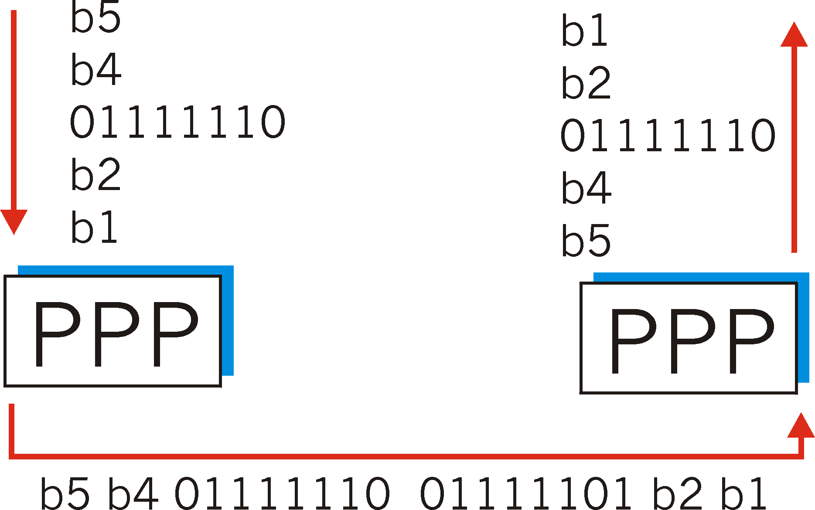
Byte Stuffing
flag byte
pattern
in data
to send
flag byte pattern plus
stuffed byte in transmitted data

Slide 9
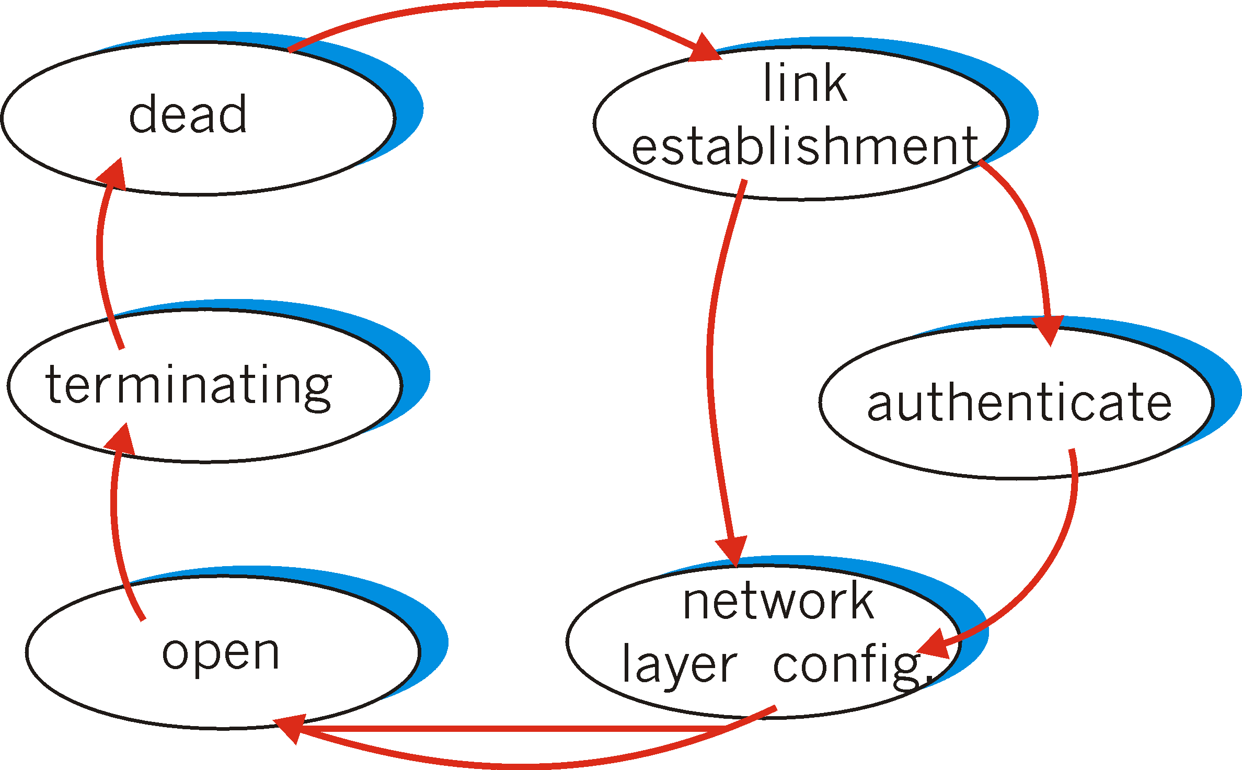
PPP Data Control Protocol
Before exchanging network-layer data, data link peers must
configure PPP link (max. frame length, authentication)
learn/configure network
layer information
for IP: carry IP Control Protocol (IPCP) msgs (protocol field: 8021) to configure/learn IP address

Slide 10
Link Layer
5.1 Introduction and services
5.2 Error detection and correction
5.3Multiple access protocols
5.4 Link-Layer Addressing
5.5 Ethernet
5.6 Hubs and switches
5.7 PPP
5.8 Link Virtualization: ATM and MPLS

Slide 11
Virtualization of networks
Virtualization of resources: powerful abstraction in systems engineering:
computing examples: virtual memory, virtual devices
Virtual machines: e.g., java
IBM VM os from 1960’s/70’s
layering of abstractions: don’t sweat the details of the lower layer, only deal with lower layers abstractly

Slide 12
The Internet: virtualizing networks
1974: multiple unconnected nets
ARPAnet
data-over-cable networks
packet satellite network (Aloha)
packet radio network
… differing in:
addressing conventions
packet formats
error recovery
routing
ARPAnet
satellite net
"A Protocol for Packet Network Intercommunication",
V. Cerf, R. Kahn, IEEE Transactions on Communications,
May, 1974, pp. 637-648.

Slide 13
The Internet: virtualizing networks
Internetwork layer (IP):
addressing: internetwork appears as single, uniform entity, despite underlying local network heterogeneity
network of networks
Gateway:
“embed internetwork packets in local packet format or extract them”
route (at internetwork level) to next gateway
gateway
ARPAnet
satellite net

Slide 14
Cerf & Kahn’s Internetwork Architecture
What is virtualized?
two layers of addressing: internetwork and local network
new layer (IP) makes everything homogeneous at internetwork layer
underlying local network technology
cable
satellite
56K telephone modem
today: ATM, MPLS
… “invisible” at internetwork layer. Looks like a link layer technology to IP!

Slide 15
ATM and MPLS
ATM, MPLS separate networks in their own right
different service models, addressing, routing from Internet
viewed by Internet as logical link connecting IP routers
just like dialup link is really part of separate network (telephone network)
ATM, MPLS: of technical interest in their own right

Slide 16
Asynchronous Transfer Mode: ATM
1990’s/00 standard for high-speed (155Mbps to 622 Mbps and higher) Broadband Integrated Service Digital Network architecture
Goal: integrated, end-end transport of carry voice, video, data
meeting timing/QoS requirements of voice, video (versus Internet best-effort model)
“next generation” telephony: technical roots in telephone world
packet-switching (fixed length packets, called “cells”) using virtual circuits

Slide 17
ATM architecture
AAL
AAL
ATM
ATM
ATM
ATM
physical
physical
physical
physical
end system
switch
switch
end system
adaptation layer: only at edge of ATM network
data segmentation/reassembly
roughly analagous to Internet transport layer
ATM layer: “network” layer
cell switching, routing
physical layer

Slide 18
ATM: network or link layer?
Vision: end-to-end transport: “ATM from desktop to desktop”
ATM is a network technology
Reality: used to connect IP backbone routers
“IP over ATM”
ATM as switched link layer, connecting IP routers
IP
network
ATM
network

Slide 19
ATM Adaptation Layer (AAL)
ATM Adaptation Layer (AAL): “adapts” upper layers (IP or native ATM applications) to ATM layer below
AAL present only in end systems, not in switches
AAL layer segment (header/trailer fields, data) fragmented across multiple ATM cells
analogy: TCP segment in many IP packets
AAL
AAL
ATM
ATM
ATM
ATM
physical
physical
physical
physical
end system
switch
switch
end system

Slide 20
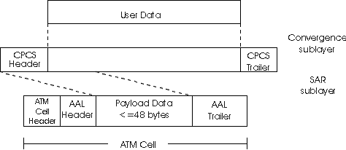
ATM Adaptation Layer (AAL) [more]
Different versions of AAL layers, depending on ATM service class:
AAL1: for CBR (Constant Bit Rate) services, e.g. circuit emulation
AAL2: for VBR (Variable Bit Rate) services, e.g., MPEG video
AAL5: for data (eg, IP datagrams)
User data
AAL PDU
ATM cell

Slide 21
ATM Layer
Service: transport cells across ATM network
analogous to IP network layer
very different services than IP network layer
Network
Architecture
Internet
ATM
ATM
ATM
ATM
Service
Model
best effort
CBR
VBR
ABR
UBR
Guarantees ?
Congestion
feedback
no (inferred
via loss)
no
congestion
no
congestion
yes
no
Bandwidth
none
constant
rate
guaranteed
rate
guaranteed
minimum
none
Loss
no
yes
yes
no
no
Order
no
yes
yes
yes
yes
Timing
no
yes
yes
no
no

Slide 22
ATM Layer: Virtual Circuits
VC transport: cells carried on VC from source to dest
call setup, teardown for each call before data can flow
each packet carries VC identifier (not destination ID)
every switch on source-dest path maintain “state” for each passing connection
link,switch resources (bandwidth, buffers) may be allocated to VC: to get circuit-like perf.
Permanent VCs (PVCs)
long lasting connections
typically: “permanent” route between to IP routers
Switched VCs (SVC):
dynamically set up on per-call basis

Slide 23
ATM VCs
Advantages of ATM VC approach:
QoS performance guarantee for connection mapped to VC (bandwidth, delay, delay jitter)
Drawbacks of ATM VC approach:
Inefficient support of datagram traffic
one PVC between each source/dest pair) does not scale (N*2 connections needed)
SVC introduces call setup latency, processing overhead for short lived connections

Slide 24
ATM Layer: ATM cell
5-byte ATM cell header
48-byte payload
Why?: small payload -> short cell-creation delay for digitized voice
halfway between 32 and 64 (compromise!)
Cell header
Cell format

Slide 25
ATM cell header
VCI: virtual channel ID
will change from link to link thru net
PT: Payload type (e.g. RM cell versus data cell)
CLP: Cell Loss Priority bit
CLP = 1 implies low priority cell, can be discarded if congestion
HEC: Header Error Checksum
cyclic redundancy check

Slide 26
ATM Physical Layer (more)
Two pieces (sublayers) of physical layer:
Transmission Convergence Sublayer (TCS): adapts ATM layer above to PMD sublayer below
Physical Medium Dependent: depends on physical medium being used
TCS Functions:
Header checksum generation: 8 bits CRC
Cell delineation
With “unstructured” PMD sublayer, transmission of idle cells when no data cells to send

Slide 27
ATM Physical Layer
Physical Medium Dependent (PMD) sublayer
SONET/SDH: transmission frame structure (like a container carrying bits);
bit synchronization;
bandwidth partitions (TDM);
several speeds: OC3 = 155.52 Mbps; OC12 = 622.08 Mbps; OC48 = 2.45 Gbps, OC192 = 9.6 Gbps
TI/T3: transmission frame structure (old telephone hierarchy): 1.5 Mbps/ 45 Mbps
unstructured: just cells (busy/idle)

Slide 28
IP-Over-ATM
IP over ATM
replace “network” (e.g., LAN segment) with ATM network
ATM addresses, IP addresses
Classic IP only
3 “networks” (e.g., LAN segments)
MAC (802.3) and IP addresses
ATM
network
Ethernet
LANs
Ethernet
LANs

Slide 29
IP-Over-ATM
app
transport
IP
AAL
ATM
phy
app
transport
IP
Eth
phy
IP
AAL
ATM
phy
Eth
ATM
phy
phy
ATM
phy

Slide 30
Datagram Journey in IP-over-ATM Network
at Source Host:
IP layer maps between IP, ATM dest address (using ARP)
passes datagram to AAL5
AAL5 encapsulates data, segments cells, passes to ATM layer
ATM network: moves cell along VC to destination
at Destination Host:
AAL5 reassembles cells into original datagram
if CRC OK, datagram is passed to IP

Slide 31
IP-Over-ATM
Issues:
IP datagrams into ATM AAL5 PDUs
from IP addresses to ATM addresses
just like IP addresses to 802.3 MAC addresses!
ATM
network
Ethernet
LANs

Slide 32
Multiprotocol label switching (MPLS)
initial goal: speed up IP forwarding by using fixed length label (instead of IP address) to do forwarding
borrowing ideas from Virtual Circuit (VC) approach
but IP datagram still keeps IP address!
PPP or Ethernet
header
IP header
remainder of link-layer frame
MPLS header
label
Exp
S
TTL
20
3
1
5

Slide 33
MPLS capable routers
a.k.a. label-switched router
forwards packets to outgoing interface based only on label value (don’t inspect IP address)
MPLS forwarding table distinct from IP forwarding tables
signaling protocol needed to set up forwarding
RSVP-TE
forwarding possible along paths that IP alone would not allow (e.g., source-specific routing) !!
use MPLS for traffic engineering
must co-exist with IP-only routers

Slide 34
MPLS forwarding tables
in out out
label label dest interface
10 A 0
in out out
label label dest interface
12 D 0
8 A 1
10 6 A 1
12 9 D 0
R6
0
0
D
1
1
R4
R3
R5
0
0
A
R2
in out out
label label dest interface
R1
in out out
label label dest interface
6 - A 0
8 6 A 0

Slide 35
Chapter 5: Summary
principles behind data link layer services:
error detection, correction
sharing a broadcast channel: multiple access
link layer addressing
instantiation and implementation of various link layer technologies
Ethernet
switched LANS
PPP
virtualized networks as a link layer: ATM, MPLS

Slide 36
Chapter 5: let’s take a breath
journey down protocol stack complete (except PHY)
solid understanding of networking principles, practice
….. could stop here …. but lots of interesting topics!
Wireless – for a more advanced class
Multimedia – Not time this year: too much IP Subnetting
security – Join me in CPTR 427
network management

