Slide 1
Link Layer
5.1 Introduction and services
5.2 Error detection and correction
5.3 Multiple access protocols
5.4 Link-layer Addressing
5.5 Ethernet
5.6 Link-layer switches
5.7 PPP
5.8 Link Virtualization: ATM, MPLS

Slide 2
Hubs
… physical-layer (“dumb”) repeaters:
bits coming in one link go out all other links at same rate
all nodes connected to hub can collide with one another
no frame buffering
no CSMA/CD at hub: host NICs detect collisions
twisted pair
hub

Slide 3
Switch
link-layer device: smarter than hubs, take active role
store, forward Ethernet frames
examine incoming frame’s MAC address, selectively forward frame to one-or-more outgoing links when frame is to be forwarded on segment, uses CSMA/CD to access segment
transparent
hosts are unaware of presence of switches
plug-and-play, self-learning
switches do not need to be configured

Slide 4
Switch: allows multiple simultaneous transmissions
A
hosts have dedicated, direct connection to switch
switches buffer packets
Ethernet protocol used on each incoming link, but no collisions; full duplex
each link is its own collision domain
switching: A-to-A’ and B-to-B’ simultaneously, without collisions
not possible with dumb hub
C’
B
1
2
6
3
5
4
C
B’
A’
switch with six interfaces
(1,2,3,4,5,6)

Slide 5
Switch Table
A
Q: how does switch know that A’ reachable via interface 4, B’ reachable via interface 5?
A: each switch has a switch table, each entry:
(MAC address of host, interface to reach host, time stamp)
looks like a routing table!
Q: how are entries created, maintained in switch table?
something like a routing protocol?
C’
B
1
2
6
3
5
4
C
B’
A’
switch with six interfaces
(1,2,3,4,5,6)

Slide 6
Switch: self-learning
Source: A
Dest: A’
A
A A’
switch learns which hosts can be reached through which interfaces
when frame received, switch “learns” location of sender: incoming LAN segment
records sender/location pair in switch table
C’
B
1
2
6
3
5
4
C
B’
A’
MAC addr interface TTL
A
1
60
Switch table
(initially empty)

Slide 7
Switch: frame filtering/forwarding
When frame received:
1. record link associated with sending host
2. index switch table using MAC dest address
3. if entry found for destination then {
if dest on segment from which frame arrived then drop the frame
else forward the frame on interface indicated
}
else flood
forward on all but the interface
on which the frame arrived

Slide 8
Self-learning, forwarding: example
Source: A
Dest: A’
A
A A’
C’
B
frame destination unknown:
1
2
flood
6
3
A A’
A A’
A A’
A A’
A A’
5
4
destination A location known:
C
selective send
A’ A
B’
A’
MAC addr interface TTL
A
1
60
Switch table
(initially empty)
A’
4
60

Slide 9
Interconnecting switches
switches can be connected together
S₄
S₁
S₃
A
S₂
F
I
B
C
D
E
G
H
Q: sending from A to G - how does S₁ know to forward frame destined to F via S₄ and S₃?
A: self learning! (works exactly the same as in single-switch case!)

Slide 10
Self-learning multi-switch example
Suppose C sends frame to I, I responds to C
1
S₄
S₁
2
S₃
A
S₂
F
I
B
C
D
E
G
H
Q: show switch tables and packet forwarding in S₁, S₂, S₃, S₄

Slide 11
Institutional network
mail server
to external
network
router
web server
IP subnet

Slide 12
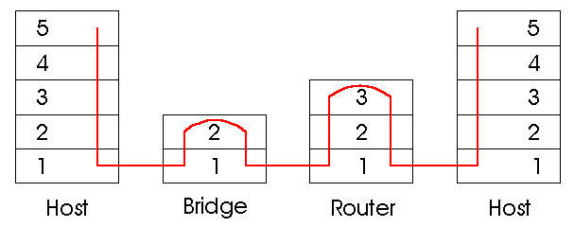
Switches vs. Routers
both store-and-forward devices
routers: network layer devices (examine network layer headers)
switches are link layer devices
routers maintain routing tables, implement routing algorithms
switches maintain switch tables, implement filtering, learning algorithms

Slide 13
Hierarchical Switch Problems
Hierarchical scheme shown in 5.26 looks like a
great idea, but there are some issues:
Lack of traffic isolation: ARP and DHCP
Inefficient use of switches when assigning users to a group switch (think collision domain)
1
S₄
S₁
2
S₃
A
S₂
F
I
B
C
D
E
G
H
Notes:
are still broadcast throughout the LAN across all the switches. Too much ARP traffic could be a problem, and rogue DHCP servers could be hard to find. Think security and privacy.

Slide 14
Virtual Local Area Networks (VLANs)
Switch breaks the physical LAN into several VLANs, possibly on the same switch.
VLAN trunking across multipl switches
What does VLAN look like?

