Slide 1
Link Layer
5.1 Introduction and services
5.2 Error detection and correction
5.3Multiple access protocols
5.4 Link-layer Addressing
5.5 Ethernet
5.6 Link-layer switches
5.7 PPP
5.8 Link Virtualization: ATM, MPLS

Slide 2
Multiple Access Links and Protocols
Two types of “links”:
point-to-point
PPP for dial-up access
point-to-point link between Ethernet switch and host
broadcast (shared wire or medium)
old-fashioned Ethernet
upstream HFC
802.11 wireless LAN
humans at a
cocktail party
(shared air, acoustical)
shared wire (e.g.,
cabled Ethernet)
shared RF
(e.g., 802.11 WiFi)
shared RF
(satellite)

Slide 3
Multiple Access protocols
single shared broadcast channel
two or more simultaneous transmissions by nodes: interference
collision if node receives two or more signals at the same time
multiple access protocol
distributed algorithm that determines how nodes share channel, i.e., determine when node can transmit
communication about channel sharing must use channel itself!
no out-of-band channel for coordination

Slide 4
Ideal Multiple Access Protocol
Broadcast channel of rate R bps
1. when one node wants to transmit, it can send at rate R.
2. when M nodes want to transmit, each can send at average rate R/M
3. fully decentralized:
no special node to coordinate transmissions
no synchronization of clocks, slots
4. simple

Slide 5
MAC Protocols: a taxonomy
Three broad classes:
Channel Partitioning
divide channel into smaller “pieces” (time slots, frequency, code)
allocate piece to node for exclusive use
Random Access
channel not divided, allow collisions
“recover” from collisions
“Taking turns”
nodes take turns, but nodes with more to send can take longer turns

Slide 6
Channel Partitioning MAC protocols: TDMA
TDMA: time division multiple access
access to channel in "rounds"
each station gets fixed length slot (length = pkt trans time) in each round
unused slots go idle
example: 6-station LAN, 1,3,4 have pkt, slots 2,5,6 idle
6-slot
frame
1
3
4
1
3
4

Slide 7
Channel Partitioning MAC protocols: FDMA
FDMA: frequency division multiple access
channel spectrum divided into frequency bands
each station assigned fixed frequency band
unused transmission time in frequency bands go idle
example: 6-station LAN, 1,3,4 have pkt, frequency bands 2,5,6 idle
time
frequency bands
FDM cable

Slide 8
Random Access Protocols
When node has packet to send
transmit at full channel data rate R.
no a priori coordination among nodes
two or more transmitting nodes ➜ “collision”,
random access MAC protocol specifies:
how to detect collisions
how to recover from collisions (e.g., via delayed retransmissions)
Examples of random access MAC protocols:
slotted ALOHA
ALOHA
CSMA, CSMA/CD, CSMA/CA

Slide 9
Slotted ALOHA
Assumptions:
all frames same size
time divided into equal size slots (time to transmit 1 frame)
nodes start to transmit only slot beginning
nodes are synchronized
if 2 or more nodes transmit in slot, all nodes detect collision
Operation:
when node obtains fresh frame, transmits in next slot
if no collision: node can send new frame in next slot
if collision: node retransmits frame in each subsequent slot with prob. p until success

Slide 10
Slotted ALOHA
Pros
single active node can continuously transmit at full rate of channel
highly decentralized: only slots in nodes need to be in sync
simple
Cons
collisions, wasting slots
idle slots
nodes may be able to detect collision in less than time to transmit packet
clock synchronization

Slide 11
Slotted Aloha efficiency
Efficiency : long-run fraction of successful slots (many nodes, all with many frames to send)
max efficiency: find p* that maximizes Np(1-p)^{N-1}
for many nodes, take limit of Np*(1-p*)^{N-1} as N goes to infinity, gives:
Max efficiency = 1/e = .37
suppose: N nodes with many frames to send, each transmits in slot with probability p
prob that given node has success in a slot = p(1-p)^{N-1}
prob that any node has a success = Np(1-p)^{N-1}
At best: channel
used for useful
transmissions 37%
of time!
!

Slide 12
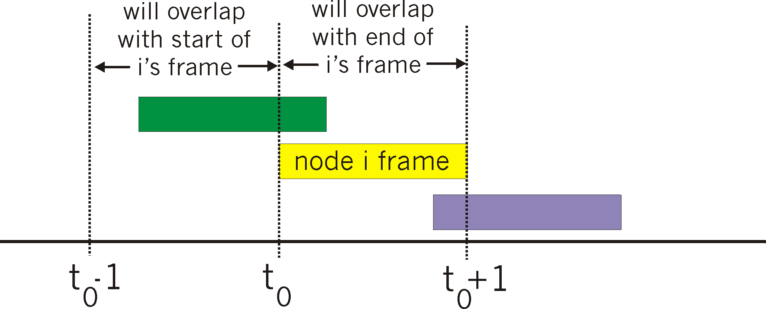
Pure (unslotted) ALOHA
unslotted Aloha: simpler, no synchronization
when frame first arrives
transmit immediately
collision probability increases:
frame sent at t₀ collides with other frames sent in [t₀-1,t₀+1]

Slide 13
Pure Aloha efficiency
P(success by given node) = P(node transmits) .
P(no other node transmits in [p₀-1,p₀] .
P(no other node transmits in [p₀-1,p₀]
= p . (1-p)^{N-1 .} (1-p)^{N-1}
= p . (1-p)^{2(N-1)}
… choosing optimum p and then letting n -> infty ...
^{= 1/(2e) = .18}
even worse than slotted Aloha!

Slide 14
CSMA (Carrier Sense Multiple Access)
CSMA: listen before transmit:
If channel sensed idle: transmit entire frame
If channel sensed busy, defer transmission
human analogy: don’t interrupt others!

Slide 15
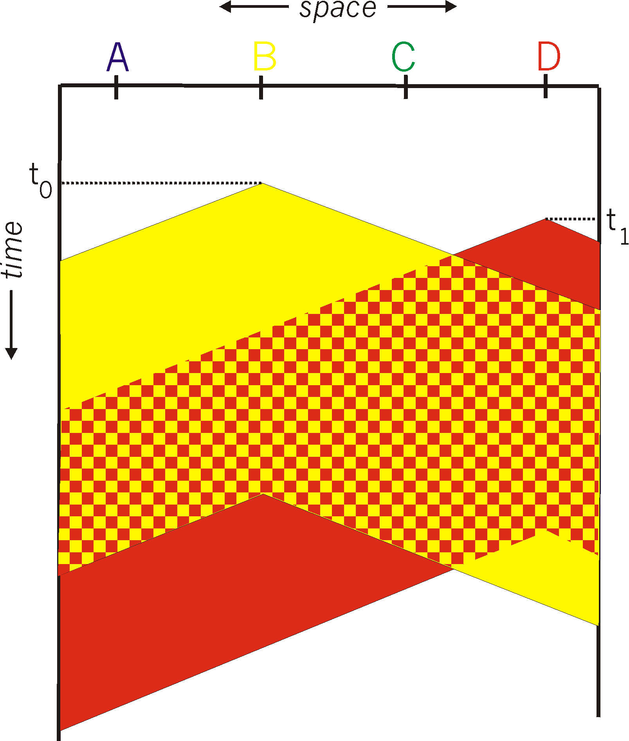
CSMA collisions
spatial layout of nodes
collisions can still occur:
propagation delay means
two nodes may not hear
each other’s transmission
collision:
entire packet transmission
time wasted
note:
role of distance & propagation delay in determining collision probability

Slide 16
CSMA/CD (Collision Detection)
CSMA/CD: carrier sensing, deferral as in CSMA
collisions detected within short time
colliding transmissions aborted, reducing channel wastage
collision detection:
easy in wired LANs: measure signal strengths, compare transmitted, received signals
difficult in wireless LANs: received signal strength overwhelmed by local transmission strength
human analogy: the polite conversationalist

Slide 17
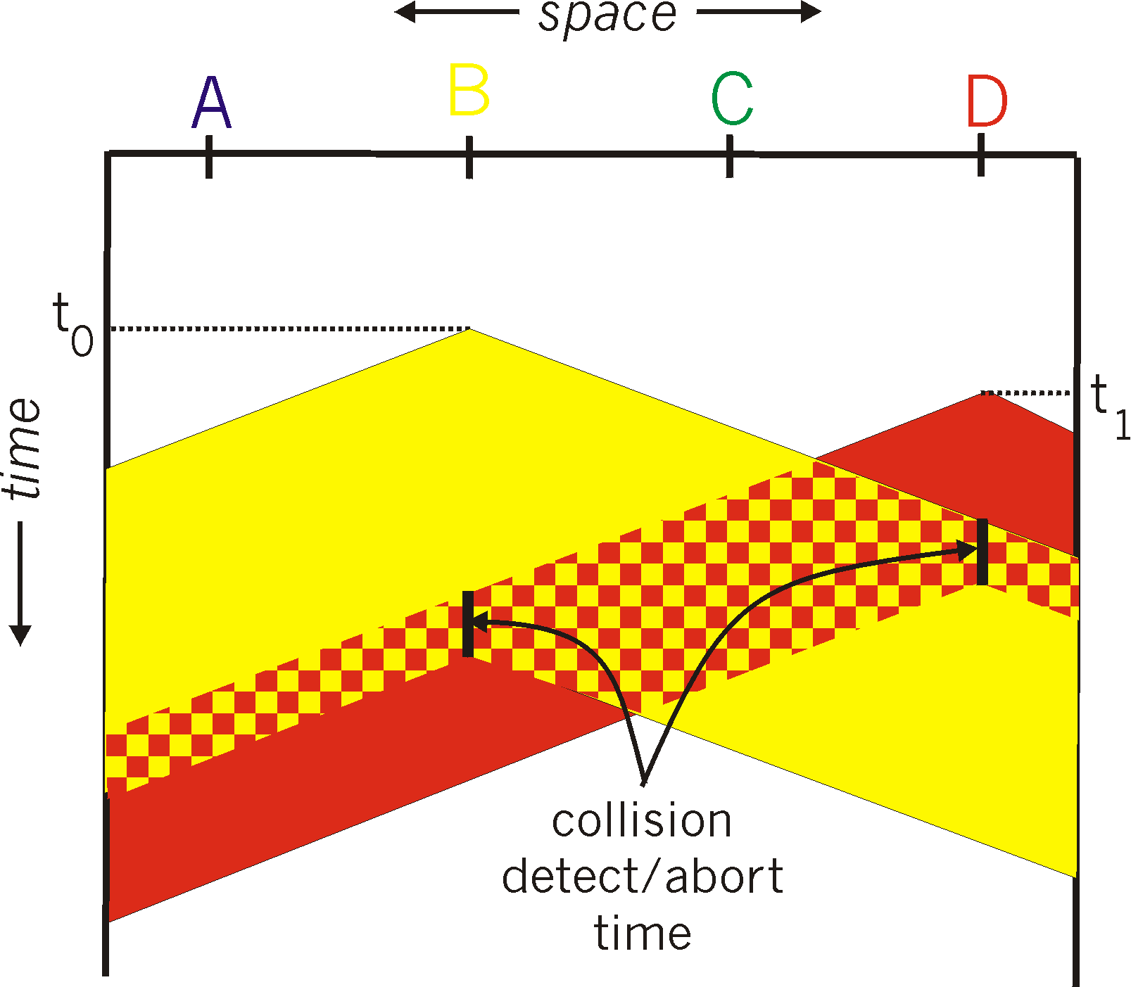
CSMA/CD collision detection

Slide 18
“Taking Turns” MAC protocols
channel partitioning MAC protocols:
share channel efficiently and fairly at high load
inefficient at low load: delay in channel access, 1/N bandwidth allocated even if only 1 active node!
Random access MAC protocols
efficient at low load: single node can fully utilize channel
high load: collision overhead
“taking turns” protocols
look for best of both worlds!

Slide 19
“Taking Turns” MAC protocols
Polling:
master node “invites” slave nodes to transmit in turn
typically used with “dumb” slave devices
concerns:
polling overhead
latency
single point of failure (master)
data
poll
master
data
slaves

Slide 20
“Taking Turns” MAC protocols
Token passing:
control token passed from one node to next sequentially.
token message
concerns:
token overhead
latency
single point of failure (token)
T
(nothing
to send)
T
data

Slide 21
Summary of MAC protocols
channel partitioning, by time, frequency or code
Time Division, Frequency Division
random access (dynamic),
ALOHA, S-ALOHA, CSMA, CSMA/CD
carrier sensing: easy in some technologies (wire), hard in others (wireless)
CSMA/CD used in Ethernet
CSMA/CA used in 802.11
taking turns
polling from central site, token passing
Bluetooth, FDDI, IBM Token Ring

Slide 22
Link Layer
5.1 Introduction and services
5.2 Error detection and correction
5.3Multiple access protocols
5.4 Link-Layer Addressing
5.5 Ethernet
5.6 Link-layer switches
5.7 PPP
5.8 Link Virtualization: ATM, MPLS

Slide 23
MAC Addresses and ARP
32-bit IP address:
network-layer address
used to get datagram to destination IP subnet
MAC (or LAN or physical or Ethernet) address:
function: get frame from one interface to another physically-connected interface (same network)
48 bit MAC address (for most LANs)
burned in NIC ROM, also sometimes software settable

Slide 24
LAN Addresses and ARP
Each adapter on LAN has unique LAN address
1A-2F-BB-76-09-AD
Broadcast address =
FF-FF-FF-FF-FF-FF
LAN
(wired or
wireless)
= adapter
71-65-F7-2B-08-53
58-23-D7-FA-20-B0
0C-C4-11-6F-E3-98

Slide 25
LAN Address (more)
MAC address allocation administered by IEEE
manufacturer buys portion of MAC address space (to assure uniqueness)
analogy:
(a) MAC address: like Social Security Number
(b) IP address: like postal address
MAC flat address ➜ portability
can move LAN card from one LAN to another
IP hierarchical address NOT portable
address depends on IP subnet to which node is attached

Slide 26
ARP: Address Resolution Protocol
Question: how to determine
MAC address of B
knowing B’s IP address?
Each IP node (host, router) on LAN has ARP table
ARP table: IP/MAC address mappings for some LAN nodes
< IP address; MAC address; TTL>
TTL (Time To Live): time after which address mapping will be forgotten (typically 20 min)
137.196.7.78
1A-2F-BB-76-09-AD
137.196.7.23
137.196.7.14
LAN
71-65-F7-2B-08-53
58-23-D7-FA-20-B0
0C-C4-11-6F-E3-98
137.196.7.88

Slide 27
ARP protocol: Same LAN (network)
A wants to send datagram to B, and B’s MAC address not in A’s ARP table.
A broadcasts ARP query packet, containing B's IP address
dest MAC address = FF-FF-FF-FF-FF-FF
all machines on LAN receive ARP query
B receives ARP packet, replies to A with its (B's) MAC address
frame sent to A’s MAC address (unicast)
A caches (saves) IP-to-MAC address pair in its ARP table until information becomes old (times out)
soft state: information that times out (goes away) unless refreshed
ARP is “plug-and-play”:
nodes create their ARP tables without intervention from net administrator

Slide 28
Addressing: routing to another LAN
walkthrough: send datagram from A to B via R
assume A knows B’s IP address
two ARP tables in router R, one for each IP network (LAN)
74-29-9C-E8-FF-55
88-B2-2F-54-1A-0F
A
E6-E9-00-17-BB-4B
222.222.222.221
111.111.111.111
1A-23-F9-CD-06-9B
222.222.222.220
222.222.222.222
111.111.111.110
B
111.111.111.112
R
49-BD-D2-C7-56-2A
CC-49-DE-D0-AB-7D

Slide 29
A creates IP datagram with source A, destination B
A uses ARP to get R’s MAC address for 111.111.111.110
A creates link-layer frame with R's MAC address as dest, frame contains A-to-B IP datagram
A’s NIC sends frame
R’s NIC receives frame
R removes IP datagram from Ethernet frame, sees its destined to B
R uses ARP to get B’s MAC address
R creates frame containing A-to-B IP datagram sends to B
This is a really important
example – make sure you
understand!
74-29-9C-E8-FF-55
88-B2-2F-54-1A-0F
A
E6-E9-00-17-BB-4B
222.222.222.221
111.111.111.111
1A-23-F9-CD-06-9B
222.222.222.220
222.222.222.222
111.111.111.110
B
111.111.111.112
R
49-BD-D2-C7-56-2A
CC-49-DE-D0-AB-7D

