Slide 1
Chapter 4: Network Layer
4. 1 Introduction
4.2 Virtual circuit and datagram networks
4.3 What’s inside a router
4.4 IP: Internet Protocol
Datagram format
IPv4 addressing
ICMP
IPv6
4.5 Routing algorithms
Link state
Distance Vector
Hierarchical routing
4.6 Routing in the Internet
RIP
OSPF
BGP
4.7 Broadcast and multicast routing

Slide 2
The Internet Network layer
Host, router network layer functions:
Transport layer: TCP, UDP
Routing protocols
path selection
RIP, OSPF, BGP
IP protocol
addressing conventions
datagram format
packet handling conventions
Network
layer
forwarding
table
ICMP protocol
error reporting
router “signaling”
Link layer
physical layer

Slide 3
Chapter 4: Network Layer
4. 1 Introduction
4.2 Virtual circuit and datagram networks
4.3 What’s inside a router
4.4 IP: Internet Protocol
Datagram format
IPv4 addressing
ICMP
IPv6
4.5 Routing algorithms
Link state
Distance Vector
Hierarchical routing
4.6 Routing in the Internet
RIP
OSPF
BGP
4.7 Broadcast and multicast routing

Slide 4
IP datagram format
IP protocol version
number
32 bits
total datagram
length (bytes)
header length
(bytes)
head.
len
type of
service
ver
length
for
fragmentation/
reassembly
“type” of data
flgs
fragment
offset
16-bit identifier
max number
remaining hops
(decremented at
each router)
time to
live
upper
layer
header
checksum
32 bit source IP address
upper layer protocol
to deliver payload to
32 bit destination IP address
Options (if any)
E.g. timestamp,
record route
taken, specify
list of routers
to visit.
how much overhead with TCP?
20 bytes of TCP
20 bytes of IP
= 40 bytes + app layer overhead
data
(variable length,
typically a TCP
or UDP segment)

Slide 5
IP Fragmentation & Reassembly
network links have MTU (max.transfer size) - largest possible link-level frame.
different link types, different MTUs
large IP datagram divided (“fragmented”) within net
one datagram becomes several datagrams
“reassembled” only at final destination
IP header bits used to identify, order related fragments
fragmentation:
in: one large datagram
out: 3 smaller datagrams
reassembly

Slide 6
IP Fragmentation and Reassembly
length
=4000
ID
=x
fragflag
=0
offset
=0
Example
4000 byte datagram
MTU = 1500 bytes
One large datagram becomes
several smaller datagrams
length
=1500
ID
=x
fragflag
=1
offset
=0
1480 bytes in data field
length
=1500
ID
=x
fragflag
=1
offset
=185
offset =
1480/8
length
=1040
ID
=x
fragflag
=0
offset
=370

Slide 7
Chapter 4: Network Layer
4. 1 Introduction
4.2 Virtual circuit and datagram networks
4.3 What’s inside a router
4.4 IP: Internet Protocol
Datagram format
IPv4 addressing
ICMP
IPv6
4.5 Routing algorithms
Link state
Distance Vector
Hierarchical routing
4.6 Routing in the Internet
RIP
OSPF
BGP
4.7 Broadcast and multicast routing

Slide 8
IP Addressing: introduction
IP address: 32-bit identifier for host, router interface
interface: connection between host/router and physical link
router’s typically have multiple interfaces
host typically has one interface
IP addresses associated with each interface
223.1.1.1
223.1.2.1
223.1.1.2
223.1.1.4
223.1.2.9
223.1.2.2
223.1.1.3
223.1.3.27
223.1.3.1
223.1.3.2
223.1.1.1 = 11011111 00000001 00000001 00000001
223
1
1
1

Slide 9
Subnets
IP address:
subnet part (high order bits)
host part (low order bits)
What’s a subnet ?
device interfaces with same subnet part of IP address
can physically reach each other without intervening router
223.1.1.1
223.1.2.1
223.1.1.2
223.1.1.4
223.1.2.9
223.1.1.3
223.1.2.2
223.1.3.27
subnet
223.1.3.1
223.1.3.2
network consisting of 3 subnets

Slide 10
Subnets
223.1.1.0/24
223.1.2.0/24
Recipe
To determine the subnets, detach each interface from its host or router, creating islands of isolated networks. Each isolated network is called a subnet.
223.1.3.0/24
Subnet mask: /24

Slide 11
Subnets
223.1.1.2
How many?
223.1.1.1
223.1.1.4
223.1.1.3
223.1.9.2
223.1.7.0
223.1.9.1
223.1.7.1
223.1.8.1
223.1.8.0
223.1.2.6
223.1.3.27
223.1.2.1
223.1.2.2
223.1.3.1
223.1.3.2

Slide 12
IP addressing: CIDR
CIDR: Classless InterDomain Routing
subnet portion of address of arbitrary length
address format: a.b.c.d/x, where x is # bits in subnet portion of address
subnet
part
host
part
11001000 00010111 00010000 00000000
200.23.16.0/23

Slide 13
IP addresses: how to get one?
Q: How does a host get IP address?
hard-coded by system admin in a file
Windows: control-panel->network->configuration->tcp/ip->properties
UNIX: /etc/rc.config
DHCP: Dynamic Host Configuration Protocol: dynamically get address from as server
“plug-and-play”

Slide 14
DHCP: Dynamic Host Configuration Protocol
Goal: allow host to dynamically obtain its IP address from network server when it joins network
Can renew its lease on address in use
Allows reuse of addresses (only hold address while connected an “on”)
Support for mobile users who want to join network (more shortly)
DHCP overview:
host broadcasts “DHCP discover” msg
DHCP server responds with “DHCP offer” msg
host requests IP address: “DHCP request” msg
DHCP server sends address: “DHCP ack” msg

Slide 15
DHCP client-server scenario
A
223.1.1.1
DHCP
223.1.2.1
server
223.1.1.2
223.1.1.4
223.1.2.9
B
223.1.2.2
E
arriving DHCP
client needs
address in this
network
223.1.1.3
223.1.3.27
223.1.3.1
223.1.3.2

Slide 16
DHCP client-server scenario
DHCP server: 223.1.2.5
arriving
client
DHCP discover
src : 0.0.0.0, 68
dest.: 255.255.255.255,67
yiaddr: 0.0.0.0
transaction ID: 654
DHCP offer
src: 223.1.2.5, 67
dest: 255.255.255.255, 68
yiaddrr: 223.1.2.4
transaction ID: 654
Lifetime: 3600 secs
DHCP request
src: 0.0.0.0, 68
dest:: 255.255.255.255, 67
yiaddrr: 223.1.2.4
transaction ID: 655
Lifetime: 3600 secs
time
DHCP ACK
src: 223.1.2.5, 67
dest: 255.255.255.255, 68
yiaddrr: 223.1.2.4
transaction ID: 655
Lifetime: 3600 secs

Slide 17
IP addresses: how to get one?
Q: How does network get subnet part of IP addr?
A: gets allocated portion of its provider ISP’s address space
ISP's block 11001000 00010111 00010000 00000000 200.23.16.0/20
Organization 0 11001000 00010111 00010000 00000000 200.23.16.0/23
Organization 1 11001000 00010111 00010010 00000000 200.23.18.0/23
Organization 2 11001000 00010111 00010100 00000000 200.23.20.0/23
... ….. …. ….
Organization 7 11001000 00010111 00011110 00000000 200.23.30.0/23

Slide 18
Hierarchical addressing: route aggregation
Hierarchical addressing allows efficient advertisement of routing
information:
Organization 0
200.23.16.0/23
Organization 1
200.23.18.0/23
“Send me anything
with addresses
beginning
200.23.16.0/20”
Organization 2
200.23.20.0/23
.
Fly-By-Night-ISP
.
.
.
.
Internet
Organization 7
.
200.23.30.0/23
ISPs-R-Us
“Send me anything
with addresses
beginning
199.31.0.0/16”

Slide 19
Hierarchical addressing: more specific routes
ISPs-R-Us has a more specific route to Organization 1
Organization 0
200.23.16.0/23
“Send me anything
with addresses
beginning
200.23.16.0/20”
Organization 2
200.23.20.0/23
.
Fly-By-Night-ISP
.
.
.
.
Internet
Organization 7
.
200.23.30.0/23
ISPs-R-Us
“Send me anything
with addresses
beginning 199.31.0.0/16
or 200.23.18.0/23”
Organization 1
200.23.18.0/23

Slide 20
IP addressing: the last word...
Q: How does an ISP get block of addresses?
A: ICANN: Internet Corporation for Assigned
Names and Numbers
allocates addresses
manages DNS
assigns domain names, resolves disputes

Slide 21
NAT: Network Address Translation
rest of
Internet
local network
(e.g., home network)
10.0.0/24
10.0.0.1
10.0.0.4
10.0.0.2
138.76.29.7
10.0.0.3
All datagrams leaving local
network have same single source NAT IP address: 138.76.29.7,
different source port numbers
Datagrams with source or
destination in this network
have 10.0.0/24 address for
source, destination (as usual)

Slide 22
NAT: Network Address Translation
Motivation: local network uses just one IP address as far as outside world is concerned:
range of addresses not needed from ISP: just one IP address for all devices
can change addresses of devices in local network without notifying outside world
can change ISP without changing addresses of devices in local network
devices inside local net not explicitly addressable, visible by outside world (a security plus).

Slide 23
NAT: Network Address Translation
Implementation: NAT router must:
outgoing datagrams: replace (source IP address, port #) of every outgoing datagram to (NAT IP address, new port #)
. . . remote clients/servers will respond using (NAT IP address, new port #) as destination addr.
remember (in NAT translation table) every (source IP address, port #) to (NAT IP address, new port #) translation pair
incoming datagrams: replace (NAT IP address, new port #) in dest fields of every incoming datagram with corresponding (source IP address, port #) stored in NAT table

Slide 24
NAT: Network Address Translation
NAT translation table
WAN side addr LAN side addr
1: host 10.0.0.1
sends datagram to
128.119.40.186, 80
2: NAT router
changes datagram
source addr from
10.0.0.1, 3345 to
138.76.29.7, 5001,
updates table
138.76.29.7, 5001 10.0.0.1, 3345
…… ……
S: 10.0.0.1, 3345
D: 128.119.40.186, 80
10.0.0.1
1
2
S: 138.76.29.7, 5001
D: 128.119.40.186, 80
10.0.0.4
10.0.0.2
138.76.29.7
S: 128.119.40.186, 80
D: 10.0.0.1, 3345
4
S: 128.119.40.186, 80
D: 138.76.29.7, 5001
3
10.0.0.3
4: NAT router
changes datagram
dest addr from
138.76.29.7, 5001 to 10.0.0.1, 3345
3: Reply arrives
dest. address:
138.76.29.7, 5001

Slide 25
NAT: Network Address Translation
16-bit port-number field:
60,000 simultaneous connections with a single LAN-side address!
NAT is controversial:
routers should only process up to layer 3
violates end-to-end argument
NAT possibility must be taken into account by app designers, eg, P2P applications
address shortage should instead be solved by IPv6

Slide 26
NAT traversal problem
client wants to connect to server with address 10.0.0.1
server address 10.0.0.1 local to LAN (client can’t use it as destination addr)
only one externally visible NATted address: 138.76.29.7
solution 1: statically configure NAT to forward incoming connection requests at given port to server
e.g., (123.76.29.7, port 2500) always forwarded to 10.0.0.1 port 25000
10.0.0.1
Client
?
10.0.0.4
138.76.29.7
NAT
router

Slide 27
NAT traversal problem
solution 2: Universal Plug and Play (UPnP) Internet Gateway Device (IGD) Protocol. Allows NATted host to:
learn public IP address (138.76.29.7)
add/remove port mappings (with lease times)
i.e., automate static NAT port map configuration
10.0.0.1
IGD
10.0.0.4
138.76.29.7
NAT
router

Slide 28
NAT traversal problem
solution 3: relaying (used in Skype)
NATed client establishes connection to relay
External client connects to relay
relay bridges packets between to connections
2. connection to
relay initiated
by client
1. connection to
relay initiated
by NATted host
10.0.0.1
3. relaying
established
Client
138.76.29.7
NAT
router

Slide 29
Chapter 4: Network Layer
4. 1 Introduction
4.2 Virtual circuit and datagram networks
4.3 What’s inside a router
4.4 IP: Internet Protocol
Datagram format
IPv4 addressing
ICMP
IPv6
4.5 Routing algorithms
Link state
Distance Vector
Hierarchical routing
4.6 Routing in the Internet
RIP
OSPF
BGP
4.7 Broadcast and multicast routing

Slide 30
ICMP: Internet Control Message Protocol
used by hosts & routers to communicate network-level information
error reporting: unreachable host, network, port, protocol
echo request/reply (used by ping)
network-layer “above” IP:
ICMP msgs carried in IP datagrams
ICMP message: type, code plus first 8 bytes of IP datagram causing error
Type Code description
0 0 echo reply (ping)
3 0 dest. network unreachable
3 1 dest host unreachable
3 2 dest protocol unreachable
3 3 dest port unreachable
3 6 dest network unknown
3 7 dest host unknown
4 0 source quench (congestion
control - not used)
8 0 echo request (ping)
9 0 route advertisement
10 0 router discovery
11 0 TTL expired
12 0 bad IP header

Slide 31
Traceroute and ICMP
Source sends series of UDP segments to dest
First has TTL =1
Second has TTL=2, etc.
Unlikely port number
When nth datagram arrives to nth router:
Router discards datagram
And sends to source an ICMP message (type 11, code 0)
Message includes name of router& IP address
When ICMP message arrives, source calculates RTT
Traceroute does this 3 times
Stopping criterion
UDP segment eventually arrives at destination host
Destination returns ICMP “host unreachable” packet (type 3, code 3)
When source gets this ICMP, stops.

Slide 32
Chapter 4: Network Layer
4. 1 Introduction
4.2 Virtual circuit and datagram networks
4.3 What’s inside a router
4.4 IP: Internet Protocol
Datagram format
IPv4 addressing
ICMP
IPv6
4.5 Routing algorithms
Link state
Distance Vector
Hierarchical routing
4.6 Routing in the Internet
RIP
OSPF
BGP
4.7 Broadcast and multicast routing

Slide 33
IPv6
Initial motivation: 32-bit address space soon to be completely allocated.
Additional motivation:
header format helps speed processing/forwarding
header changes to facilitate QoS
IPv6 datagram format:
fixed-length 40 byte header
no fragmentation allowed

Slide 34
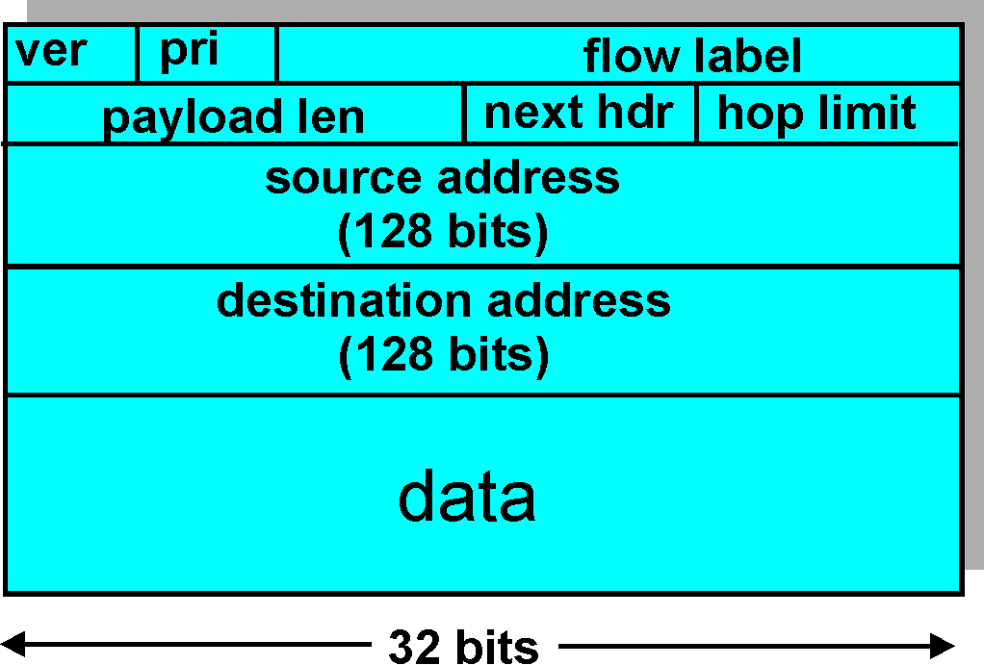
IPv6 Header (Cont)
Priority: identify priority among datagrams in flow
Flow Label: identify datagrams in same “flow.”
(concept of“flow” not well defined).
Next header: identify upper layer protocol for data

Slide 35
Other Changes from IPv4
Checksum: removed entirely to reduce processing time at each hop
Options: allowed, but outside of header, indicated by “Next Header” field
ICMPv6: new version of ICMP
additional message types, e.g. “Packet Too Big”
multicast group management functions

Slide 36
Transition From IPv4 To IPv6
Not all routers can be upgraded simultaneous
no “flag days”
How will the network operate with mixed IPv4 and IPv6 routers?
Tunneling: IPv6 carried as payload in IPv4 datagram among IPv4 routers

Slide 37
Tunneling
A
B
E
F
Logical view:
tunnel
IPv6
IPv6
IPv6
IPv6
A
B
E
F
Physical view:
IPv6
IPv6
IPv4
IPv4
IPv6
IPv6

Slide 38
Tunneling
A
B
E
F
Logical view:
tunnel
IPv6
IPv6
IPv6
IPv6
A
B
C
D
E
F
Physical view:
IPv6
IPv6
IPv4
IPv4
IPv6
IPv6
Flow: X
Src: A
Dest: F
data
Src:B
Dest: E
Src:B
Dest: E
Flow: X
Src: A
Dest: F
data
Flow: X
Src: A
Dest: F
data
Flow: X
Src: A
Dest: F
data
A-to-B:
IPv6
B-to-C:
IPv6 inside
IPv4
B-to-C:
IPv6 inside
IPv4
E-to-F:
IPv6

