Slide 1
Chapter 4: Network Layer
4. 1 Introduction
4.2 Virtual circuit and datagram networks
4.3 What’s inside a router
4.4 IP: Internet Protocol
Datagram format
IPv4 addressing
ICMP
IPv6
4.5 Routing algorithms
Link state
Distance Vector
Hierarchical routing
4.6 Routing in the Internet
RIP
OSPF
BGP
4.7 Broadcast and multicast routing

Slide 2
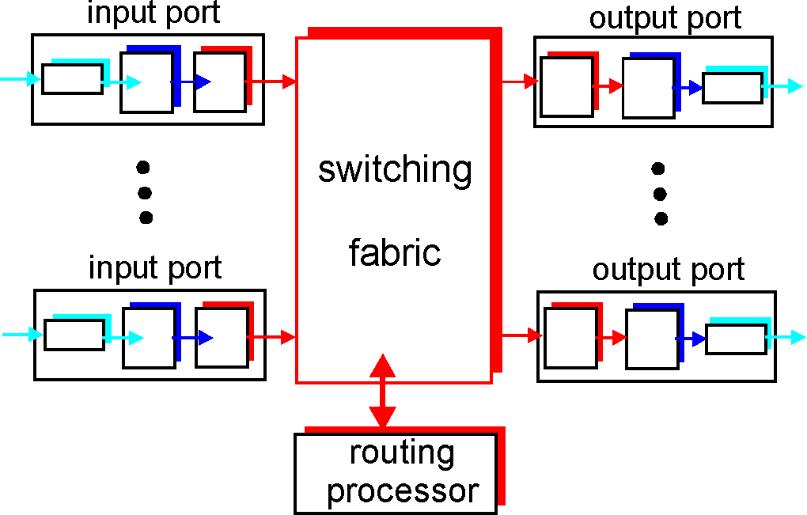
Router Architecture Overview
Two key router functions:
run routing algorithms/protocol (RIP, OSPF, BGP)
forwarding datagrams from incoming to outgoing link

Slide 3
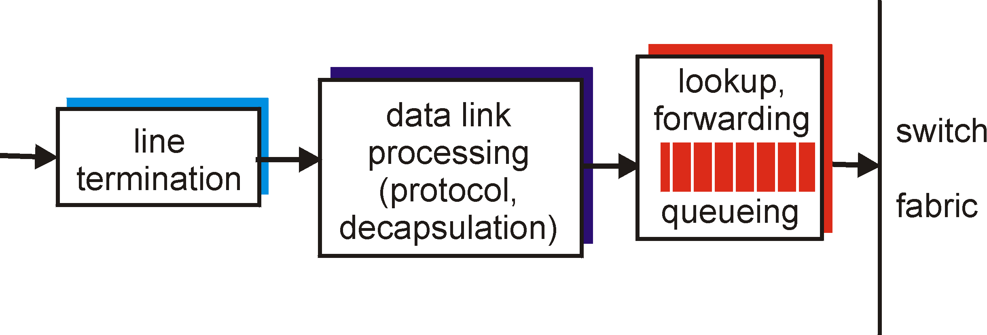
Input Port Functions
Physical layer:
bit-level reception
Data link layer:
e.g., Ethernet
see chapter 5
Decentralized switching:
given datagram dest., lookup output port using forwarding table in input port memory
goal: complete input port processing at ‘line speed’
queuing: if datagrams arrive faster than forwarding rate into switch fabric

Slide 4
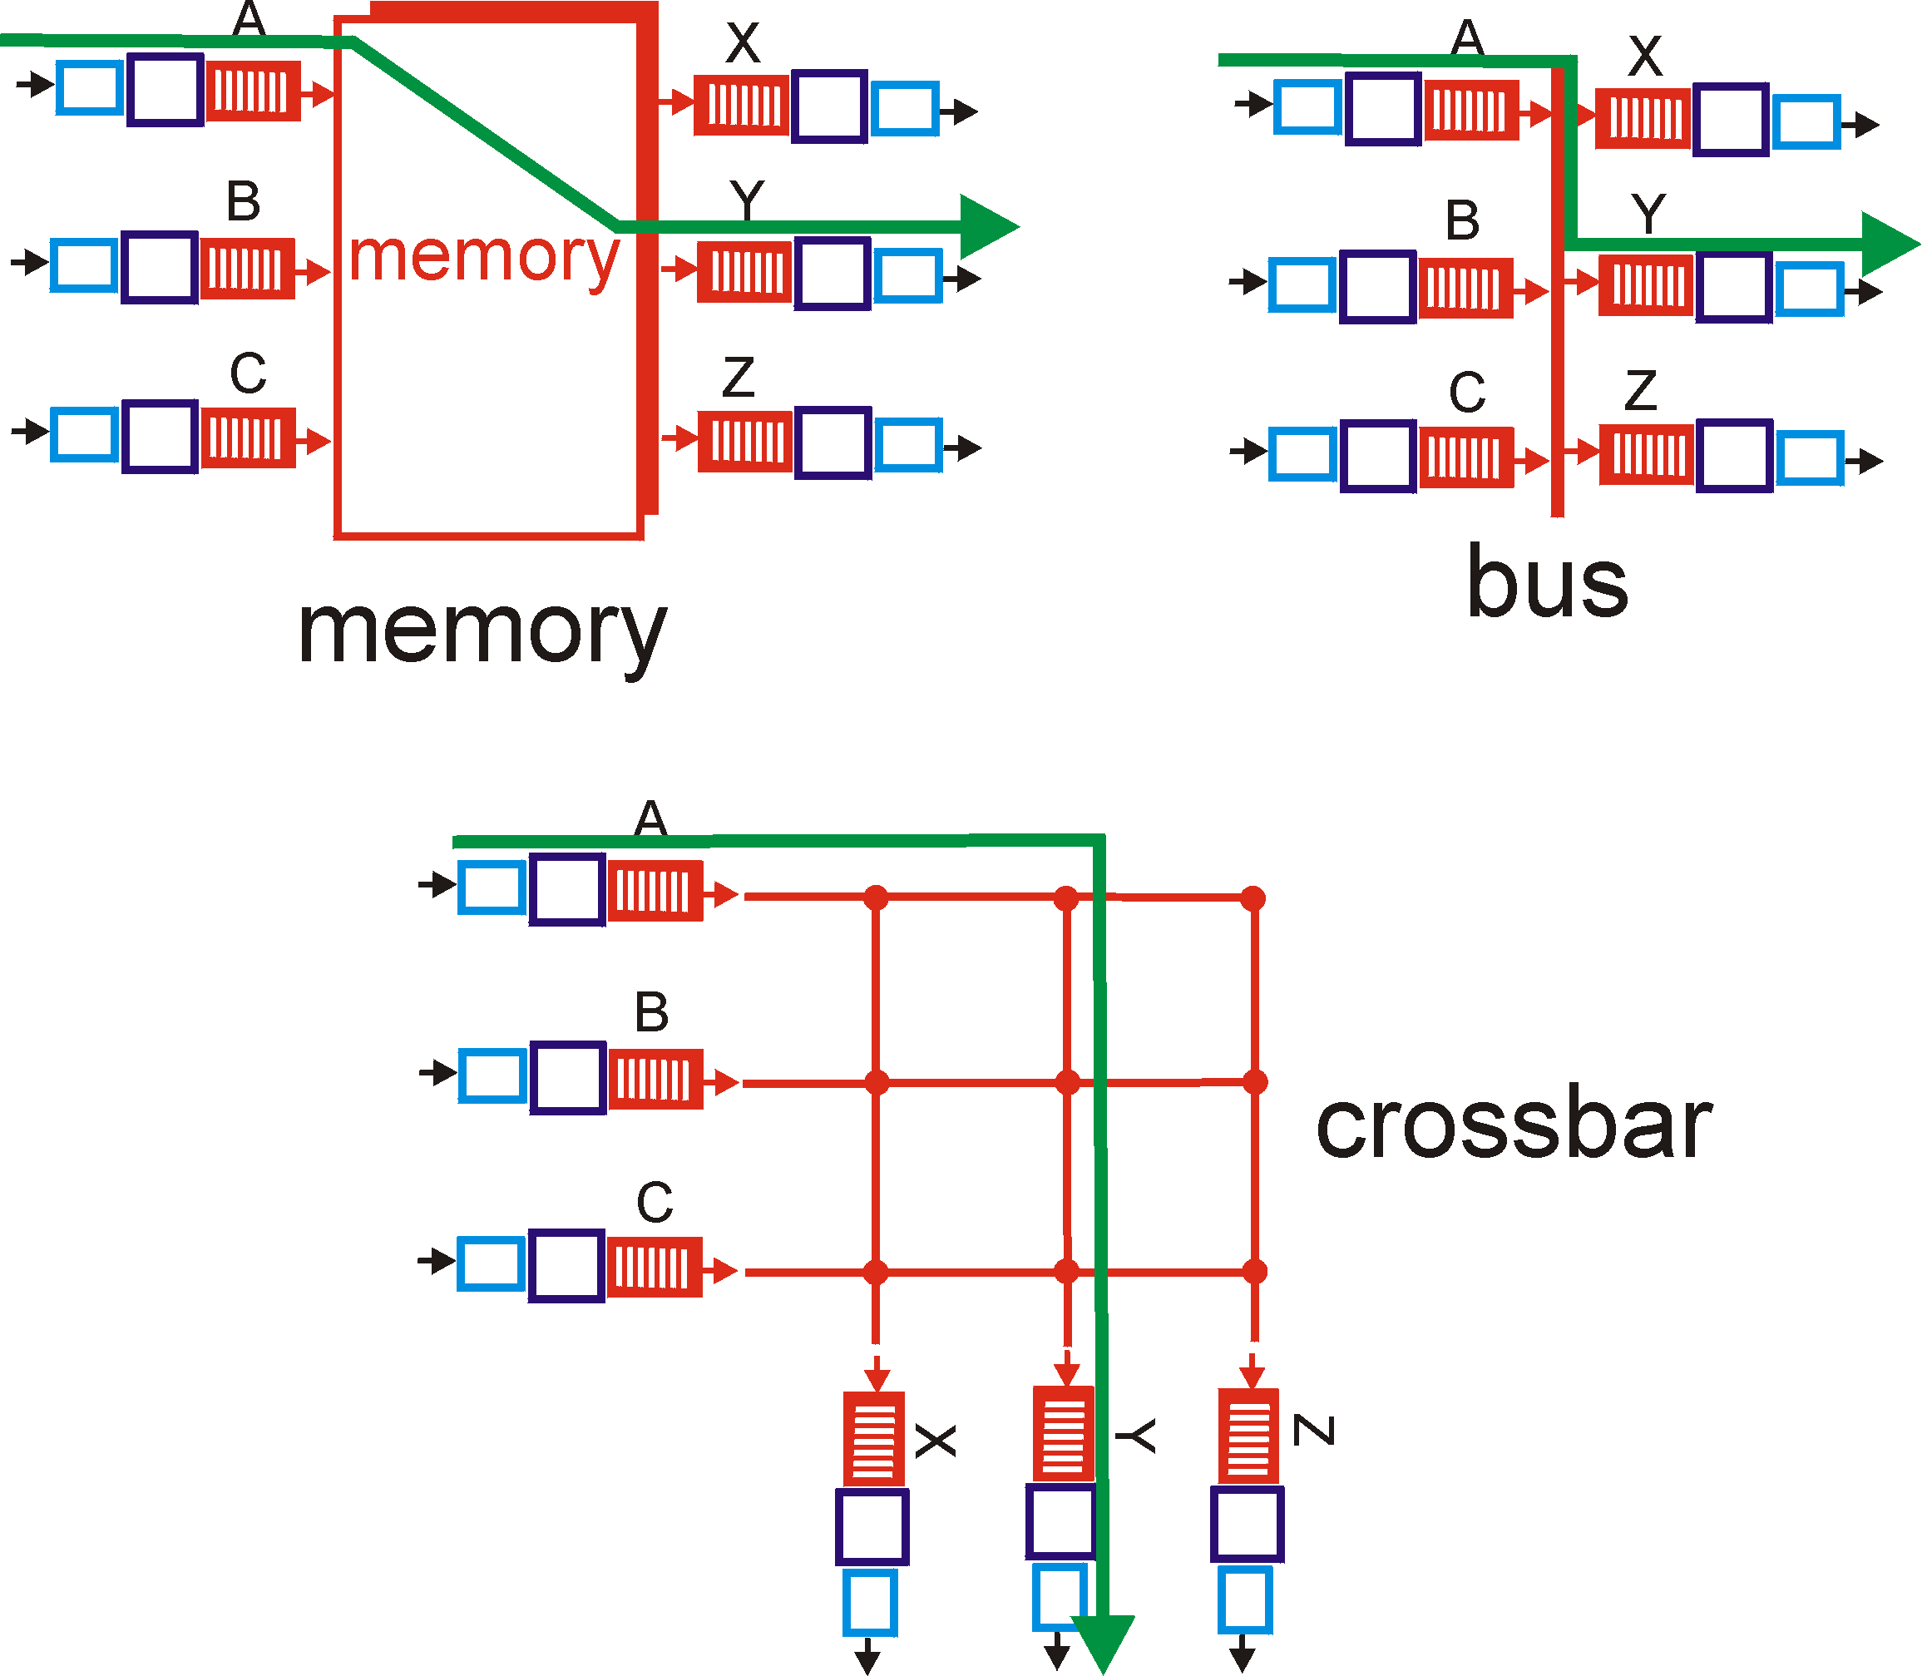
Three types of switching fabrics

Slide 5
Switching Via Memory
First generation routers:
traditional computers with switching under direct control of CPU
packet copied to system’s memory
speed limited by memory bandwidth (2 bus crossings per datagram)
Input
Port
Memory
Output
Port
System Bus

Slide 6
Switching Via a Bus
datagram from input port memory
to output port memory via a shared bus
bus contention: switching speed limited by bus bandwidth
32 Gbps bus, Cisco 5600: sufficient speed for access and enterprise routers

Slide 7
Switching Via An Interconnection Network
overcome bus bandwidth limitations
Banyan networks, other interconnection nets initially developed to connect processors in multiprocessor
advanced design: fragmenting datagram into fixed length cells, switch cells through the fabric.
Cisco 12000: switches 60 Gbps through the interconnection network

Slide 8
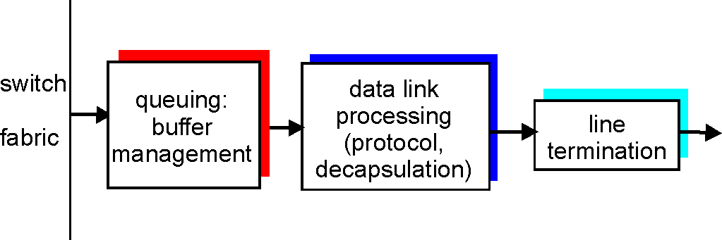
Output Ports
Buffering required when datagrams arrive from fabric faster than the transmission rate
Scheduling discipline chooses among queued datagrams for transmission

Slide 9
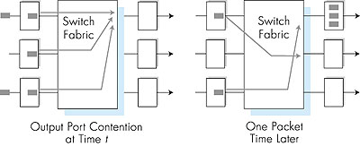
Output port queueing
buffering when arrival rate via switch exceeds output line speed
queueing (delay) and loss due to output port buffer overflow!

Slide 10
How much buffering?
RFC 3439 rule of thumb: average buffering equal to “typical” RTT (say 250 msec) times link capacity C
e.g., C = 10 Gps link: 2.5 Gbit buffer
Recent recommendation: with N flows, buffering equal to
.
RTT C
N

Slide 11
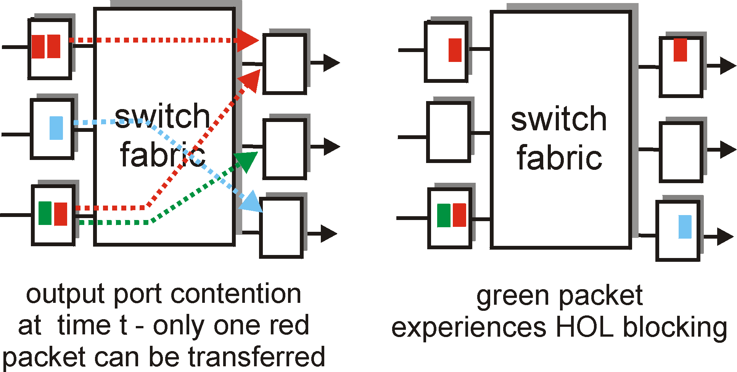
Input Port Queuing
Fabric slower than input ports combined -> queueing may occur at input queues
Head-of-the-Line (HOL) blocking: queued datagram at front of queue prevents others in queue from moving forward
queueing delay and loss due to input buffer overflow!

