Slide 1
Chapter 3 outline
3.1 Transport-layer services
3.2 Multiplexing and demultiplexing
3.3 Connectionless transport: UDP
3.4 Principles of reliable data transfer
3.5 Connection-oriented transport: TCP
segment structure
reliable data transfer
flow control
connection management
3.6 Principles of congestion control
3.7 TCP congestion control

Slide 2
Principles of Congestion Control
Congestion:
informally: “too many sources sending too much data too fast for network to handle”
different from flow control!
manifestations:
lost packets (buffer overflow at routers)
long delays (queueing in router buffers)
a top-10 problem!

Slide 3
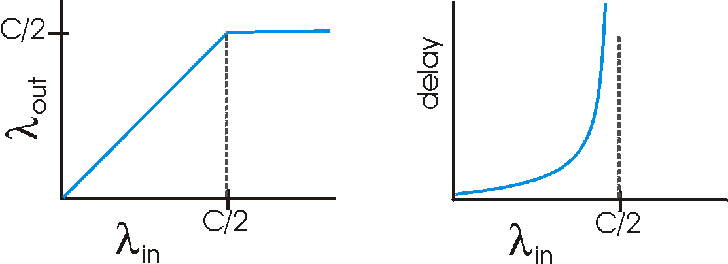
Causes/costs of congestion: scenario 1
two senders, two receivers
one router, infinite buffers
no retransmission
Host A
λ_{in} : original data
λ_{out}
Host B
unlimited shared output link buffers
C=Max throughput
large delays when congested
maximum achievable throughput
Notes:
Note:λ_{in/out} is the byte rate of information flowing in or out. Left Figure should be clear, unless you have had calculus and calc based statistics, take the one on the right on faith. To get there you need to derive Little’s Formula (See Leon-Garcia, Widjaja. Communication Networks, McGraw Hill, 2000)

Slide 4
Causes/costs of congestion: scenario 2
one router, finite buffers
sender retransmission of lost packet
Host A
λ_{in} : original data
λ_{out}
λ'_{in} : original data, plus retransmitted data
Host B
finite shared output link buffers
Notes:
λ_{out} is the rate of output that is usable (don’t count retransmitted packets if they arrive). We call this goodput.

Slide 5
Causes/costs of congestion: scenario 2
λ
λ
always: (goodput)
“perfect” retransmission only when loss:
retransmission of delayed (not lost) packet makes larger (than perfect case) for same
=
in
out
λ
>
λ
in
out
λ
λ
in
out
R/2
R/2
R/2
R/3
λ_{out}
λ_{out}
λ_{out}
R/4
λ_{in}
R/2
λ_{in}
R/2
λ_{in}
R/2
a.
b.
c.
“costs” of congestion:
more work (retrans) for given “goodput”
unneeded retransmissions: link carries multiple copies of pkt
Notes:
λ‘ Offered load (Includes both original and retransmitted packets)
Perfection – we only send when there is a known buffer available.
[1] Near Perfection – we only retransmit when we know that we have lost a packet (e.g. very large timeout)
[2] Reality – Sometimes we retransmit packets that are not lost.

Slide 6
Causes/costs of congestion: scenario 3
λ
four senders
multihop paths
timeout/retransmit
Q: what happens as and increase ?
λ
in
in
Host A
λ_{in} : original data
λ_{out}
λ'_{in} : original data, plus retransmitted data
finite shared output link buffers
Host B

Slide 7
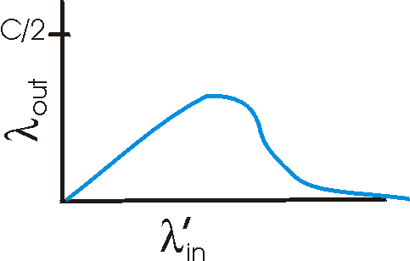
Causes/costs of congestion: scenario 3
Host A
λ_{out}
Host B
Another “cost” of congestion:
when packet dropped, any “upstream transmission capacity used for that packet was wasted!

Slide 8
Approaches towards congestion control
Two broad approaches towards congestion control:
End-end congestion control:
no explicit feedback from network
congestion inferred from end-system observed loss, delay
approach taken by TCP
Network-assisted congestion control:
routers provide feedback to end systems
single bit indicating congestion (SNA, DECbit, TCP/IP ECN, ATM)
explicit rate sender should send at
Notes:
SNA = IBM’s answer to anything that could go wrong: Systems Network Architecture
DECbit = another attempt in the 90s that requires all routers to be modified (DEC apparently comes from the company DEC for which the designer worked at the time)
TCP/IP ECN = Explicit Congestion Control
ATM = Asynchronous Transfer Mode

Slide 9
Case study: ATM ABR congestion control
ABR: available bit rate:
“elastic service”
if sender’s path “underloaded”:
sender should use available bandwidth
if sender’s path congested:
sender throttled to minimum guaranteed rate
RM (resource management) cells:
sent by sender, interspersed with data cells
bits in RM cell set by switches (“network-assisted”)
NI bit: no increase in rate (mild congestion)
CI bit: congestion indication
RM cells returned to sender by receiver, with bits intact

Slide 10
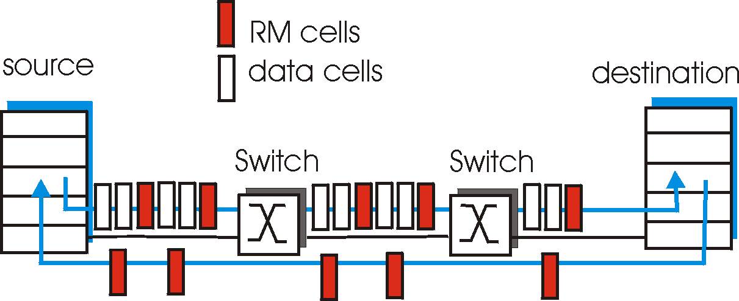
Case study: ATM ABR congestion control
two-byte ER (explicit rate) field in RM cell
congested switch may lower ER value in cell
sender’ send rate thus maximum supportable rate on path
EFCI bit in data cells: set to 1 in congested switch
if data cell preceding RM cell has EFCI set, sender sets CI bit in returned RM cell

