Slide 1
Chapter 3 outline
3.1 Transport-layer services
3.2 Multiplexing and demultiplexing
3.3 Connectionless transport: UDP
3.4 Principles of reliable data transfer
3.5 Connection-oriented transport: TCP
segment structure
reliable data transfer
flow control
connection management
3.6 Principles of congestion control
3.7 TCP congestion control

Slide 2
TCP: Overview RFCs: 793, 1122, 1323, 2018, 2581
point-to-point:
one sender, one receiver
reliable, in-order byte steam:
no “message boundaries”
pipelined:
TCP congestion and flow control set window size
send & receive buffers
full duplex data:
bi-directional data flow in same connection
MSS: maximum segment size
connection-oriented:
handshaking (exchange of control msgs) init’s sender, receiver state before data exchange
flow controlled:
sender will not overwhelm receiver

Slide 3
TCP segment structure
32 bits
URG: urgent data
(generally not used)
counting
by bytes
of data
(not segments!)
source port #
dest port #
sequence number
ACK: ACK #
valid
acknowledgement number
head
len
not
used
U
Receive window
A
P
R
S
PSH: push data now
(generally not used)
F
# bytes
rcvr willing
to accept
checksum
Urg data pnter
RST, SYN, FIN:
connection estab
(setup, teardown
commands)
Options (variable length)
application
data
(variable length)
Internet
checksum
(as in UDP)

Slide 4
TCP seq. #’s and ACKs
Seq. #’s:
byte stream “number” of first byte in segment’s data
ACKs:
seq # of next byte expected from other side
cumulative ACK
Q: how receiver handles out-of-order segments
A: TCP spec doesn’t say, - up to implementor
Host A
Host B
User
types
‘C’
Seq=42, ACK=79, data = ‘C’
host ACKs
receipt of
‘C’, echoes
back ‘C’
Seq=79, ACK=43, data = ‘C’
host ACKs
receipt
of echoed
‘C’
Seq=43, ACK=80
time
simple telnet scenario

Slide 5
TCP Round Trip Time and Timeout
Q: how to set TCP timeout value?
longer than RTT
but RTT varies
too short: premature timeout
unnecessary retransmissions
too long: slow reaction to segment loss
Q: how to estimate RTT?
SampleRTT: measured time from segment transmission until ACK receipt
ignore retransmissions
SampleRTT will vary, want estimated RTT “smoother”
average several recent measurements, not just current SampleRTT

Slide 6
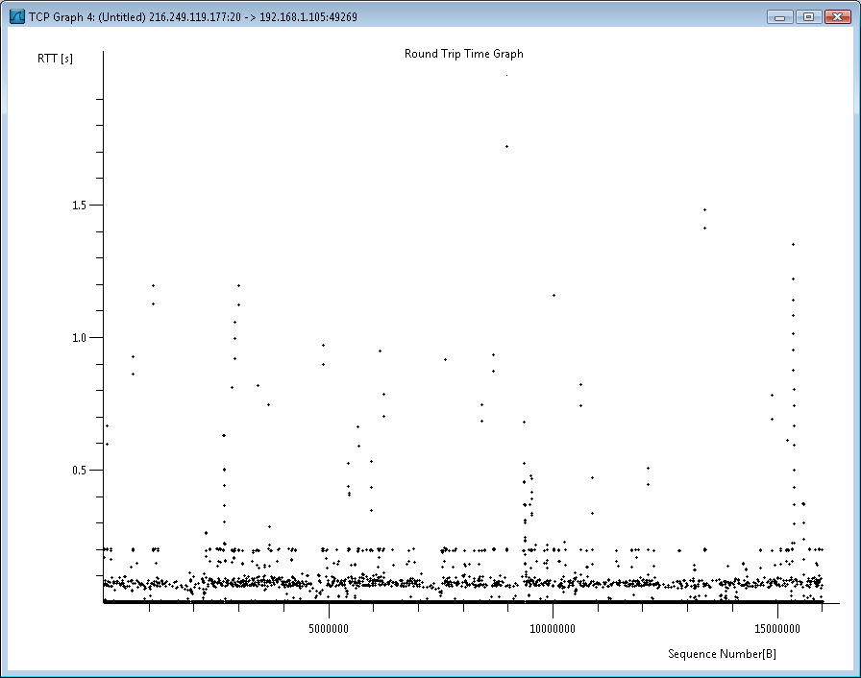
TCP Round Trip Time and Timeout
EstimatedRTT = (1- α)*EstimatedRTT + α*SampleRTT
Exponential weighted moving average
influence of past sample decreases exponentially fast
typical value: α = 0.125
Calculating EstimatedRTT is easiest done in Excel/Calc
RTT Graph for FTP download www.cs.southern.edu → home
Notes:
Filter for ftp-data
Statistics, TCP Stream Graph, RTT Graph

Slide 7
Example RTT estimation:

Slide 8
TCP Round Trip Time and Timeout
Setting the timeout
EstimtedRTT plus “safety margin”
large variation in EstimatedRTT -> larger safety margin
first estimate of how much SampleRTT deviates from EstimatedRTT:
DevRTT = (1-β)*DevRTT +
β*|SampleRTT-EstimatedRTT|
(typically, β = 0.25)
Then set timeout interval:
TimeoutInterval = EstimatedRTT + 4*DevRTT

Slide 9
Chapter 3 outline
3.1 Transport-layer services
3.2 Multiplexing and demultiplexing
3.3 Connectionless transport: UDP
3.4 Principles of reliable data transfer
3.5 Connection-oriented transport: TCP
segment structure
reliable data transfer
flow control
connection management
3.6 Principles of congestion control
3.7 TCP congestion control

Slide 10
TCP reliable data transfer
TCP creates rdt service on top of IP’s unreliable service
Pipelined segments
Cumulative acks
TCP uses single retransmission timer
Retransmissions are triggered by:
timeout events
duplicate acks
Initially consider simplified TCP sender:
ignore duplicate acks
ignore flow control, congestion control

Slide 11
TCP sender events:
data rcvd from app:
Create seg. with seq #
seq # is byte-stream number of first data byte in segment
start timer if not already running (think of timer as for oldest unacked segment)
expiration interval: TimeOutInterval
timeout:
retransmit segment that caused timeout
restart timer
Ack rcvd:
If acknowledges previously unacked segments
update what is known to be acked
start timer if there are outstanding segments

Slide 12
TCP sender (simplified)
NextSeqNum = InitialSeqNum
SendBase = InitialSeqNum
loop (forever) {
switch(event)
event: data received from application above
create TCP segment with sequence number NextSeqNum
if (timer currently not running)
start timer
pass segment to IP
NextSeqNum = NextSeqNum + length(data)
event: timer timeout
retransmit not-yet-acknowledged segment with
smallest sequence number
start timer
event: ACK received, with ACK field value of y
if (y > SendBase) {
SendBase = y
if (there are currently not-yet-acknowledged segments)
start timer
}
} /* end of loop forever */
Comment:
SendBase-1: last
cumulatively ack’ed byte
Example:
SendBase-1 = 71; y= 73, so the rcvr wants 73+ ; y > SendBase, so that new data is acked

Slide 13
TCP: retransmission scenarios
Host A
Host B
Host A
Host B
Seq=92, 8 bytes data
Seq=92, 8 bytes data
Seq=100, 20 bytes data
timeout
ACK=100
Seq=92 timeout
X
ACK=100
loss
ACK=120
Seq=92, 8 bytes data
Sendbase
= 100
Seq=92, 8 bytes data
SendBase
= 120
Seq=92 timeout
ACK=120
ACK=100
SendBase
= 100
SendBase
= 120
premature timeout
time
time
lost ACK scenario

Slide 14
TCP retransmission scenarios (more)
Host A
Host B
Seq=92, 8 bytes data
ACK=100
timeout
Seq=100, 20 bytes data
X
loss
SendBase
= 120
ACK=120
time
Cumulative ACK scenario

Slide 15
TCP ACK generation [RFC 1122, RFC 2581]
Event at Receiver
Arrival of in-order segment with
expected seq #. All data up to
expected seq # already ACKed
Arrival of in-order segment with
expected seq #. One other
segment has ACK pending
Arrival of out-of-order segment
higher-than-expect seq. # .
Gap detected
Arrival of segment that
partially or completely fills gap
TCP Receiver action
Delayed ACK. Wait up to 500ms
for next segment. If no next segment,
send ACK
Immediately send single cumulative
ACK, ACKing both in-order segments
Immediately send duplicate ACK,
indicating seq. # of next expected byte
Immediate send ACK, provided that
segment starts at lower end of gap

Slide 16
Fast Retransmit
Time-out period often relatively long:
long delay before resending lost packet
Detect lost segments via duplicate ACKs.
Sender often sends many segments back-to-back
If segment is lost, there will likely be many duplicate ACKs.
If sender receives 3 ACKs for the same data, it supposes that segment after ACKed data was lost:
fast retransmit: resend segment before timer expires

Slide 17
Fast retransmit algorithm:
event: ACK received, with ACK field value of y
if (y > SendBase) {
SendBase = y
if (there are currently not-yet-acknowledged segments)
start timer
}
else {
increment count of dup ACKs received for y
if (count of dup ACKs received for y = 3) {
resend segment with sequence number y
}
a duplicate ACK for
already ACKed segment
fast retransmit

Slide 18
Chapter 3 outline
3.1 Transport-layer services
3.2 Multiplexing and demultiplexing
3.3 Connectionless transport: UDP
3.4 Principles of reliable data transfer
3.5 Connection-oriented transport: TCP
segment structure
reliable data transfer
flow control
connection management
3.6 Principles of congestion control
3.7 TCP congestion control

Slide 19
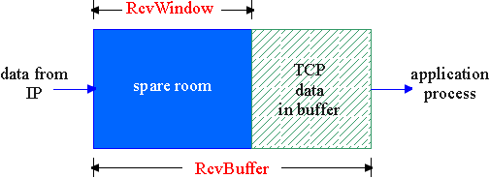
TCP Flow Control
flow control
sender won’t overflow
receiver’s buffer by
transmitting too much,
too fast
receive side of TCP connection has a receive buffer:
speed-matching service: matching the send rate to the receiving app’s drain rate
app process may be slow at reading from buffer

Slide 20
TCP Flow control: how it works
Rcvr advertises spare room by including value of RcvWindow in segments
Sender limits unACKed data to RcvWindow
guarantees receive buffer doesn’t overflow
(Suppose TCP receiver discards out-of-order segments)
spare room in buffer
= RcvWindow
= RcvBuffer-[LastByteRcvd - LastByteRead]

Slide 21
Chapter 3 outline
3.1 Transport-layer services
3.2 Multiplexing and demultiplexing
3.3 Connectionless transport: UDP
3.4 Principles of reliable data transfer
3.5 Connection-oriented transport: TCP
segment structure
reliable data transfer
flow control
connection management
3.6 Principles of congestion control
3.7 TCP congestion control

Slide 22
TCP Connection Management
Recall: TCP sender, receiver establish “connection” before exchanging data segments
initialize TCP variables:
seq. #s
buffers, flow control info (e.g. RcvWindow)
client: connection initiator
Socket clientSocket = new Socket("hostname","port number");
server: contacted by client
Socket connectionSocket = welcomeSocket.accept();
Three way handshake:
Step 1: client host sends TCP SYN segment to server
specifies initial seq #
no data
Step 2: server host receives SYN, replies with SYNACK segment
server allocates buffers
specifies server initial seq. #
Step 3: client receives SYNACK, replies with ACK segment, which may contain data

Slide 23
TCP Connection Management (cont.)
Closing a connection:
client closes socket: clientSocket.close();
Step 1: client end system sends TCP FIN control segment to server
Step 2: server receives FIN, replies with ACK. Closes connection, sends FIN.
client
server
close
FIN
ACK
close
FIN
ACK
timed wait
closed

Slide 24
TCP Connection Management (cont.)
Step 3: client receives FIN, replies with ACK.
Enters “timed wait” - will respond with ACK to received FINs
Step 4: server, receives ACK. Connection closed.
Note: with small modification, can handle simultaneous FINs.
client
server
closing
FIN
ACK
closing
FIN
ACK
timed wait
closed
closed

Slide 25
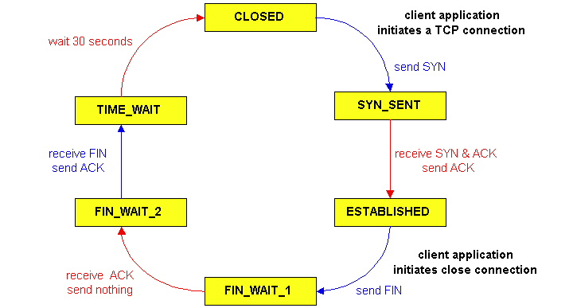
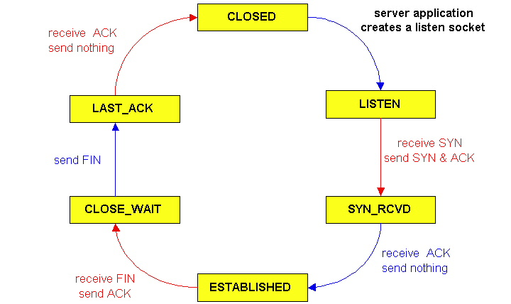
TCP Connection Management (cont)
TCP server
lifecycle
TCP client
lifecycle

