Slide 1
Chapter 3 outline
3.1 Transport-layer services
3.2 Multiplexing and demultiplexing
3.3 Connectionless transport: UDP
3.4 Principles of reliable data transfer
3.5 Connection-oriented transport: TCP
segment structure
reliable data transfer
flow control
connection management
3.6 Principles of congestion control
3.7 TCP congestion control

Slide 2
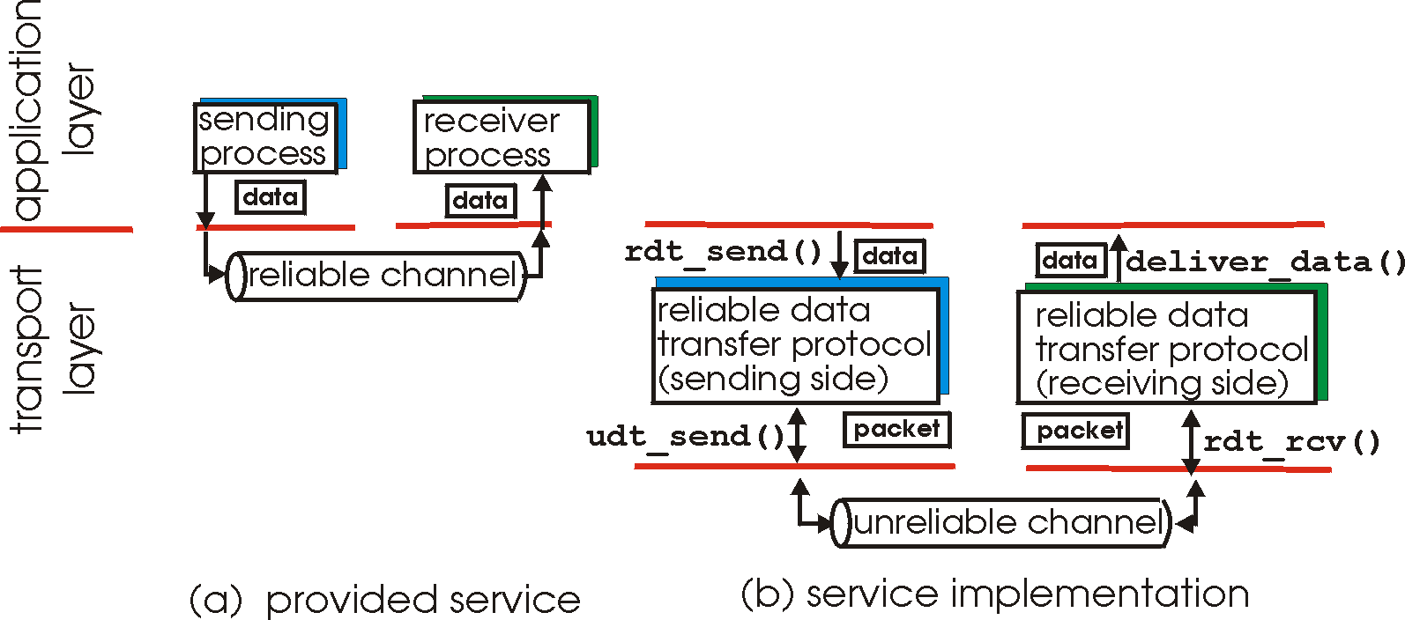
Principles of Reliable data transfer
important in app., transport, link layers
top-10 list of important networking topics!
characteristics of unreliable channel will determine complexity of reliable data transfer protocol (rdt)

Slide 3
Principles of Reliable data transfer
important in app., transport, link layers
top-10 list of important networking topics!
characteristics of unreliable channel will determine complexity of reliable data transfer protocol (rdt)

Slide 4
Principles of Reliable data transfer
important in app., transport, link layers
top-10 list of important networking topics!
characteristics of unreliable channel will determine complexity of reliable data transfer protocol (rdt)

Slide 5
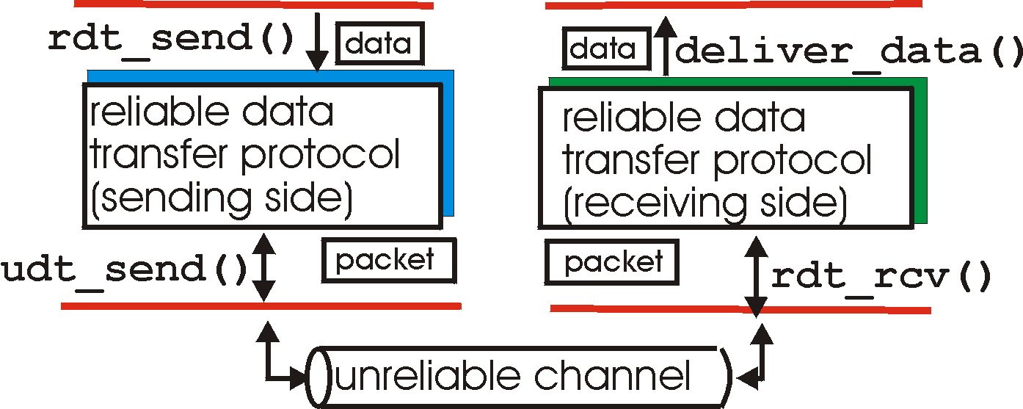
Reliable data transfer: getting started
rdt_send(): called from above, (e.g., by app.). Passed data to
deliver to receiver upper layer
deliver_data(): called by rdt to deliver data to upper
send
side
receive
side
udt_send(): called by rdt,
to transfer packet over
unreliable channel to receiver
rdt_rcv(): called when packet arrives on rcv-side of channel

Slide 6
Reliable data transfer: getting started
We will:
incrementally develop sender, receiver sides of reliable data transfer protocol (rdt)
consider only unidirectional data transfer
but control info will flow in both directions!
use finite state machines (FSM) to specify sender, receiver
event causing state transition
actions taken on state transition
state: when in this “state” next state uniquely determined by next event
state
1
state
2
event
actions

Slide 7
Rdt1.0: reliable transfer over a reliable channel
underlying channel perfectly reliable
no bit errors
no loss of packets
separate FSMs for sender, receiver:
sender sends data into underlying channel
receiver read data from underlying channel
Wait for call from above
rdt_send(data)
Wait for call from below
rdt_rcv(packet)
extract (packet,data)
deliver_data(data)
packet = make_pkt(data)
udt_send(packet)
sender
receiver

Slide 8
Rdt2.0: channel with bit errors
underlying channel may flip bits in packet
checksum to detect bit errors
the question: how to recover from errors:
acknowledgements (ACKs): receiver explicitly tells sender that pkt received OK
negative acknowledgements (NAKs): receiver explicitly tells sender that pkt had errors
sender retransmits pkt on receipt of NAK
new mechanisms in rdt2.0 (beyond rdt1.0):
error detection
receiver feedback: control msgs (ACK,NAK) rcvr->sender

Slide 9
rdt2.0: FSM specification
rdt_send(data)
snkpkt = make_pkt(data, checksum)
udt_send(sndpkt)
receiver
rdt_rcv(rcvpkt) &&
isNAK(rcvpkt)
Wait for call from above
Wait for ACK or NAK
rdt_rcv(rcvpkt) &&
corrupt(rcvpkt)
udt_send(sndpkt)
udt_send(NAK)
rdt_rcv(rcvpkt) && isACK(rcvpkt)
Λ
Wait for call from below
sender
rdt_rcv(rcvpkt) &&
notcorrupt(rcvpkt)
extract(rcvpkt,data)
deliver_data(data)
udt_send(ACK)

Slide 10
rdt2.0: operation with no errors
rdt_send(data)
snkpkt = make_pkt(data, checksum)
udt_send(sndpkt)
rdt_rcv(rcvpkt) &&
isNAK(rcvpkt)
rdt_rcv(rcvpkt) &&
corrupt(rcvpkt)
Wait for call from above
Wait for ACK or NAK
udt_send(sndpkt)
udt_send(NAK)
rdt_rcv(rcvpkt) && isACK(rcvpkt)
Wait for call from below
Λ
rdt_rcv(rcvpkt) &&
notcorrupt(rcvpkt)
extract(rcvpkt,data)
deliver_data(data)
udt_send(ACK)

Slide 11
rdt2.0: error scenario
rdt_send(data)
snkpkt = make_pkt(data, checksum)
udt_send(sndpkt)
rdt_rcv(rcvpkt) &&
isNAK(rcvpkt)
rdt_rcv(rcvpkt) &&
corrupt(rcvpkt)
Wait for call from above
Wait for ACK or NAK
udt_send(sndpkt)
udt_send(NAK)
rdt_rcv(rcvpkt) && isACK(rcvpkt)
Wait for call from below
Λ
rdt_rcv(rcvpkt) &&
notcorrupt(rcvpkt)
extract(rcvpkt,data)
deliver_data(data)
udt_send(ACK)

Slide 12
rdt2.0 has a fatal flaw!
What happens if ACK/NAK corrupted?
sender doesn’t know what happened at receiver!
can’t just retransmit: possible duplicate
Handling duplicates:
sender retransmits current pkt if ACK/NAK garbled
sender adds sequence number to each pkt
receiver discards (doesn’t deliver up) duplicate pkt
stop and wait
Sender sends one packet,
then waits for receiver
response

Slide 13
rdt2.1: sender, handles garbled ACK/NAKs
rdt_send(data)
sndpkt = make_pkt(0, data, checksum)
udt_send(sndpkt)
rdt_rcv(rcvpkt) &&
(corrupt(rcvpkt)||isNAK(rcvpkt))
Wait for call 0 from above
Wait for ACK or NAK 0
udt_send(sndpkt)
rdt_rcv(rcvpkt)
&& notcorrupt(rcvpkt)
&& isACK(rcvpkt)
rdt_rcv(rcvpkt)
&& notcorrupt(rcvpkt)
&& isACK(rcvpkt)
Λ
Λ
Wait for ACK or NAK 1
Wait for
call 1 from above
rdt_rcv(rcvpkt) &&
( corrupt(rcvpkt) ||
isNAK(rcvpkt) )
rdt_send(data)
udt_send(sndpkt)
sndpkt = make_pkt(1, data, checksum)
udt_send(sndpkt)

Slide 14
rdt2.1: receiver, handles garbled ACK/NAKs
rdt_rcv(rcvpkt) && notcorrupt(rcvpkt)
&& has_seq0(rcvpkt)
extract(rcvpkt,data)
deliver_data(data)
sndpkt = make_pkt(ACK, chksum)
udt_send(sndpkt)
rdt_rcv(rcvpkt) && (corrupt(rcvpkt)
rdt_rcv(rcvpkt) && (corrupt(rcvpkt)
sndpkt = make_pkt(NAK, chksum)
udt_send(sndpkt)
sndpkt = make_pkt(NAK, chksum)
udt_send(sndpkt)
Wait for
0 from below
Wait for
1 from below
rdt_rcv(rcvpkt) &&
not corrupt(rcvpkt) &&
has_seq1(rcvpkt)
rdt_rcv(rcvpkt) &&
not corrupt(rcvpkt) &&
has_seq0(rcvpkt)
sndpkt = make_pkt(ACK, chksum)
udt_send(sndpkt)
sndpkt = make_pkt(ACK, chksum)
udt_send(sndpkt)
rdt_rcv(rcvpkt) && notcorrupt(rcvpkt)
&& has_seq1(rcvpkt)
extract(rcvpkt,data)
deliver_data(data)
sndpkt = make_pkt(ACK, chksum)
udt_send(sndpkt)

Slide 15
rdt2.1: discussion
Sender:
seq # added to pkt
two seq. #’s (0,1) will suffice. Why?
must check if received ACK/NAK corrupted
twice as many states
state must “remember” whether “current” pkt has 0 or 1 seq. #
Receiver:
must check if received packet is duplicate
state indicates whether 0 or 1 is expected pkt seq #
note: receiver can not know if its last ACK/NAK received OK at sender

Slide 16
rdt2.2: a NAK-free protocol
same functionality as rdt2.1, using ACKs only
instead of NAK, receiver sends ACK for last pkt received OK
receiver must explicitly include seq # of pkt being ACKed
duplicate ACK at sender results in same action as NAK: retransmit current pkt

Slide 17
rdt2.2: sender, receiver fragments
rdt_send(data)
sndpkt = make_pkt(0, data, checksum)
udt_send(sndpkt)
rdt_rcv(rcvpkt) &&
( corrupt(rcvpkt) ||
isACK(rcvpkt,1) )
Wait for call 0 from above
Wait for ACK
0
udt_send(sndpkt)
sender FSM
fragment
rdt_rcv(rcvpkt)
&& notcorrupt(rcvpkt)
&& isACK(rcvpkt,0)
rdt_rcv(rcvpkt) &&
(corrupt(rcvpkt) || has_seq1(rcvpkt))
Λ
Wait for
0 from below
receiver FSM
fragment
udt_send(sndpkt)
rdt_rcv(rcvpkt) && notcorrupt(rcvpkt)
&& has_seq1(rcvpkt)
extract(rcvpkt,data)
deliver_data(data)
sndpkt = make_pkt(ACK1, chksum)
udt_send(sndpkt)

Slide 18
rdt3.0: channels with errors and loss
New assumption: underlying channel can also lose packets (data or ACKs)
checksum, seq. #, ACKs, retransmissions will be of help, but not enough
Approach: sender waits “reasonable” amount of time for ACK
retransmits if no ACK received in this time
if pkt (or ACK) just delayed (not lost):
retransmission will be duplicate, but use of seq. #’s already handles this
receiver must specify seq # of pkt being ACKed
requires countdown timer

Slide 19
rdt3.0 sender
rdt_send(data)
rdt_rcv(rcvpkt) &&
( corrupt(rcvpkt) ||
isACK(rcvpkt,1) )
sndpkt = make_pkt(0, data, checksum)
udt_send(sndpkt)
start_timer
rdt_rcv(rcvpkt)
Λ
Λ
Wait for
call 0from above
Wait for ACK0
timeout
udt_send(sndpkt)
start_timer
rdt_rcv(rcvpkt)
&& notcorrupt(rcvpkt)
&& isACK(rcvpkt,1)
rdt_rcv(rcvpkt)
&& notcorrupt(rcvpkt)
&& isACK(rcvpkt,0)
stop_timer
stop_timer
Wait for ACK1
Wait for
call 1 from above
timeout
udt_send(sndpkt)
start_timer
rdt_rcv(rcvpkt)
rdt_send(data)
Λ
rdt_rcv(rcvpkt) &&
( corrupt(rcvpkt) ||
isACK(rcvpkt,0) )
sndpkt = make_pkt(1, data, checksum)
udt_send(sndpkt)
start_timer
Λ

Slide 20
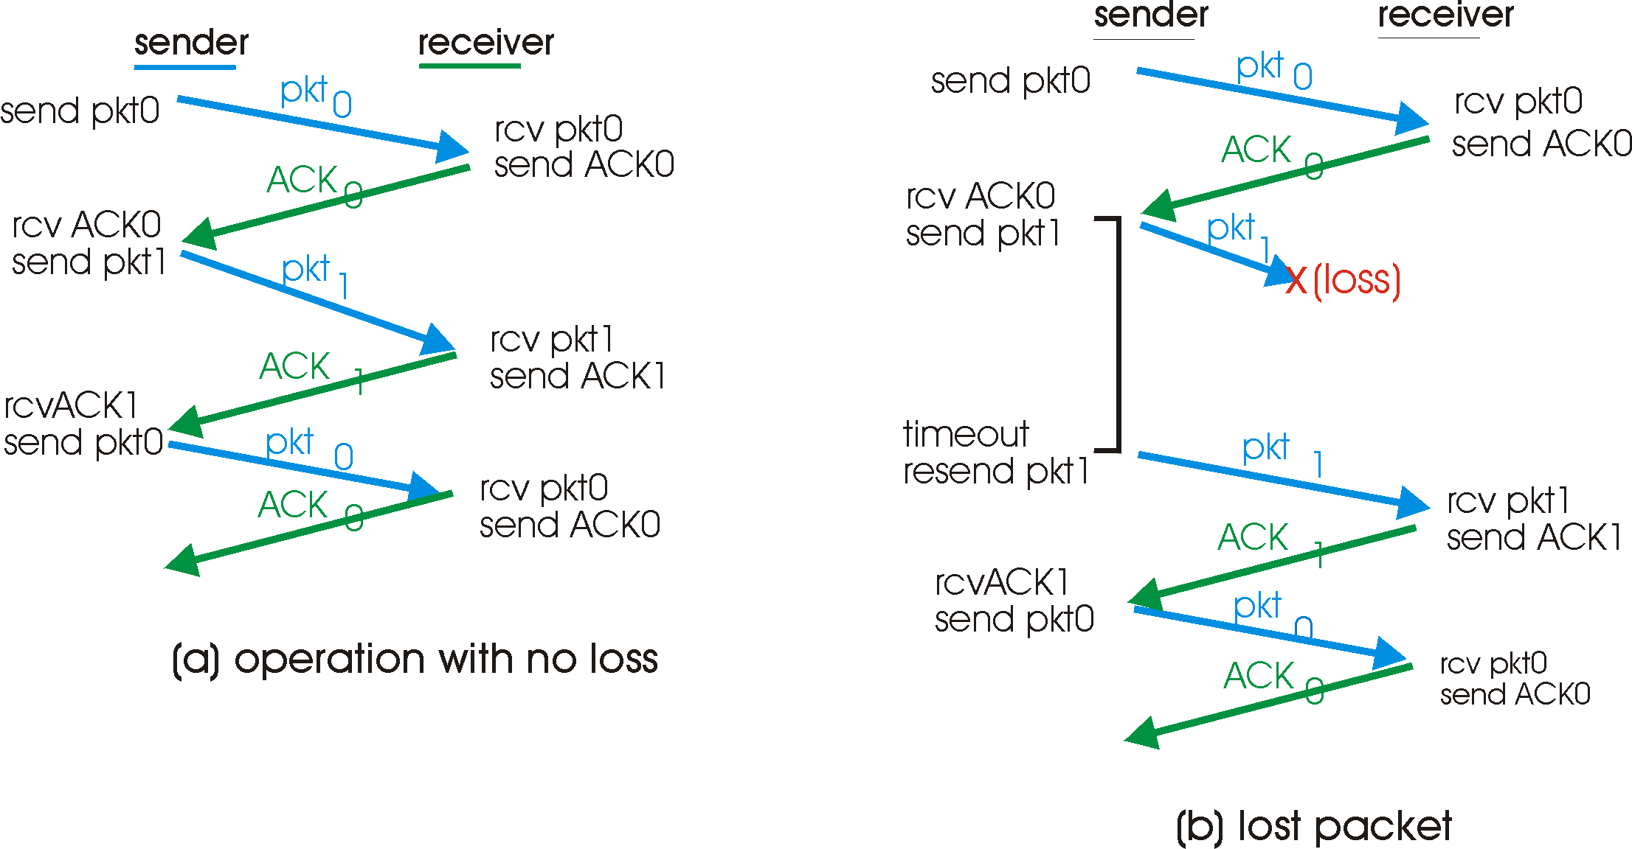
rdt3.0 in action

Slide 21
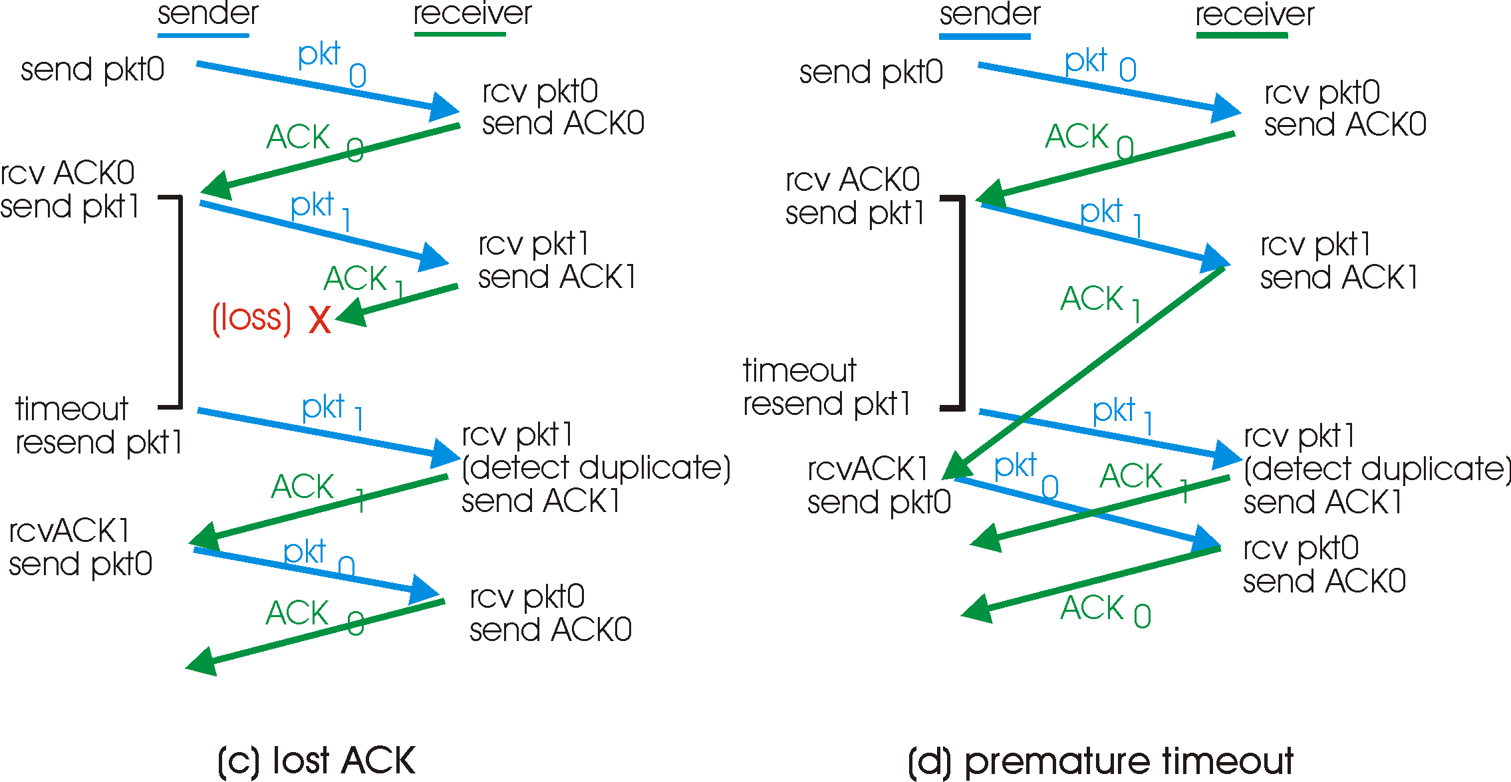
rdt3.0 in action

Slide 22
Performance of rdt3.0
rdt3.0 works, but performance stinks
example: 1 Gbps link, 15 ms e-e prop. delay, 1KB packet:
T
=
L (packet length in bits)
8kb/pkt
transmit
=
= 8 microsec
R (transmission rate, bps)
10**9 b/sec
U _{sender}: utilization – fraction of time sender busy sending
1KB pkt every 30 msec -> 33kB/sec thruput over 1 Gbps link
network protocol limits use of physical resources!

Slide 23
rdt3.0: stop-and-wait operation
sender
receiver
first packet bit transmitted, t = 0
last packet bit transmitted, t = L / R
first packet bit arrives
RTT
last packet bit arrives, send ACK
ACK arrives, send next
packet, t = RTT + L / R

Slide 24
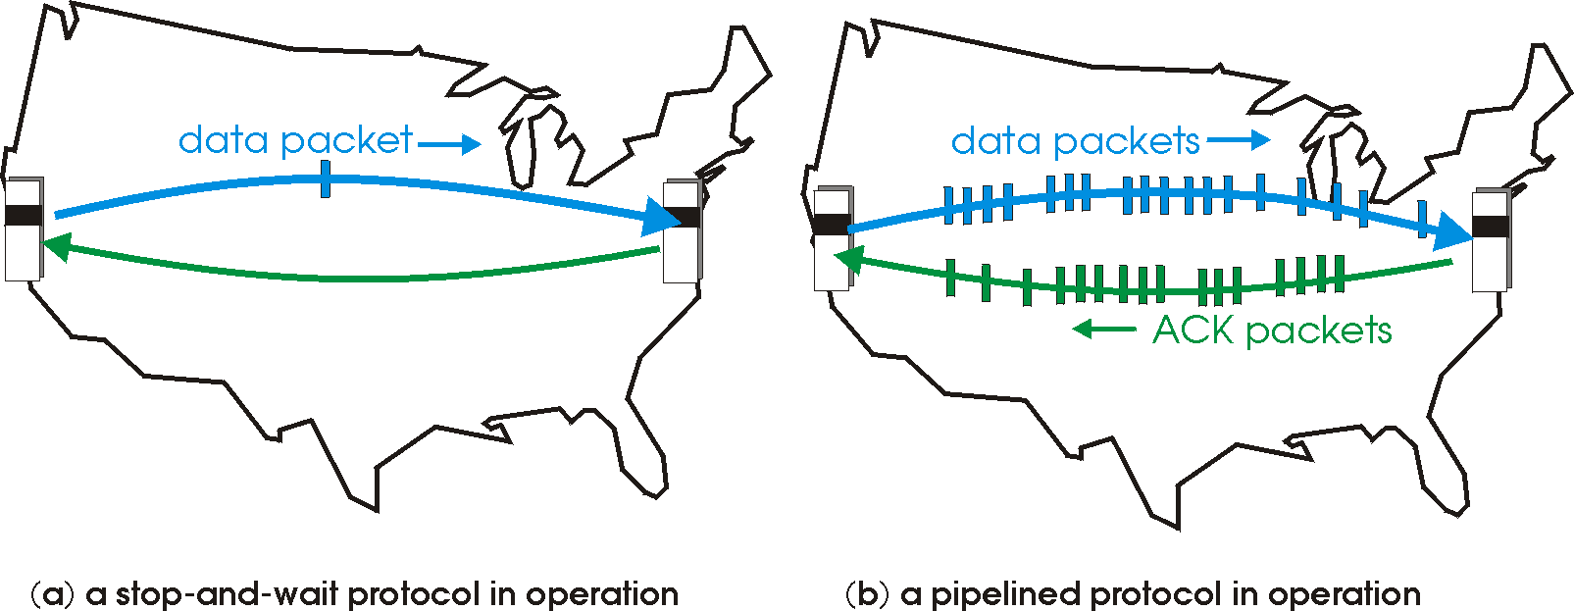
Pipelined protocols
Pipelining: sender allows multiple, “in-flight”, yet-to-be-acknowledged pkts
range of sequence numbers must be increased
buffering at sender and/or receiver
Two generic forms of pipelined protocols: go-Back-N, selective repeat

Slide 25
Pipelining: increased utilization
sender
receiver
first packet bit transmitted, t = 0
last bit transmitted, t = L / R
first packet bit arrives
RTT
last packet bit arrives, send ACK
last bit of 2nd packet arrives, send ACK
last bit of 3rd packet arrives, send ACK
ACK arrives, send next
packet, t = RTT + L / R
Increase utilization
by a factor of 3!

Slide 26
Go-Back-N
Sender:
k-bit seq # in pkt header
“window” of up to N, consecutive unack’ed pkts allowed
ACK(n): ACKs all pkts up to, including seq # n - “cumulative ACK”
may receive duplicate ACKs (see receiver)
timer for each in-flight pkt
timeout(n): retransmit pkt n and all higher seq # pkts in window

Slide 27
GBN: sender extended FSM
rdt_send(data)
if (nextseqnum < base+N) {
sndpkt[nextseqnum] = make_pkt(nextseqnum,data,chksum)
udt_send(sndpkt[nextseqnum])
if (base == nextseqnum)
start_timer
nextseqnum++
}
else
refuse_data(data)
Λ
base=1
nextseqnum=1
timeout
Wait
start_timer
udt_send(sndpkt[base])
udt_send(sndpkt[base+1])
…
udt_send(sndpkt[nextseqnum-1])
rdt_rcv(rcvpkt)
&& corrupt(rcvpkt)
rdt_rcv(rcvpkt) &&
notcorrupt(rcvpkt)
base = getacknum(rcvpkt)+1
If (base == nextseqnum)
stop_timer
else
start_timer

Slide 28
GBN: receiver extended FSM
default
udt_send(sndpkt)
rdt_rcv(rcvpkt)
&& notcurrupt(rcvpkt)
&& hasseqnum(rcvpkt,expectedseqnum)
Λ
Wait
extract(rcvpkt,data)
deliver_data(data)
sndpkt = make_pkt(expectedseqnum,ACK,chksum)
udt_send(sndpkt)
expectedseqnum++
expectedseqnum=1
sndpkt =
make_pkt(expectedseqnum,ACK,chksum)
ACK-only: always send ACK for correctly-received pkt with highest in-order seq #
may generate duplicate ACKs
need only remember expectedseqnum
out-of-order pkt:
discard (don’t buffer) -> no receiver buffering!
Re-ACK pkt with highest in-order seq #

Slide 29
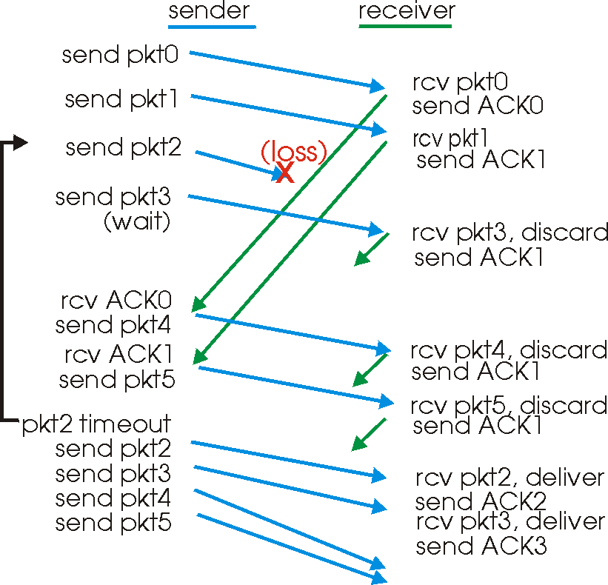
GBN in action

Slide 30
Selective Repeat
receiver individually acknowledges all correctly received pkts
buffers pkts, as needed, for eventual in-order delivery to upper layer
sender only resends pkts for which ACK not received
sender timer for each unACKed pkt
sender window
N consecutive seq #’s
again limits seq #s of sent, unACKed pkts

Slide 31
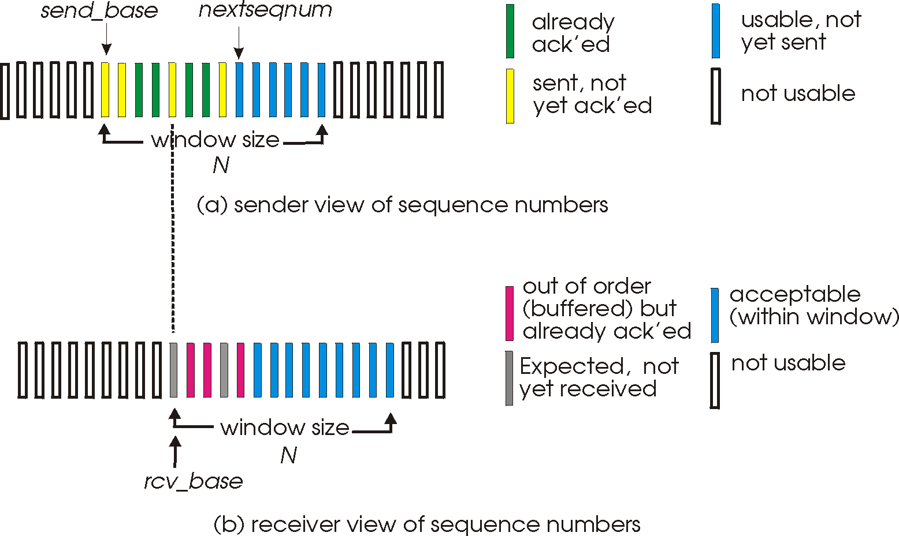
Selective repeat: sender, receiver windows

Slide 32
Selective repeat
sender
receiver
data from above :
if next available seq # in window, send pkt
timeout(n):
resend pkt n, restart timer
ACK(n) in [sendbase,sendbase+N]:
mark pkt n as received
if n smallest unACKed pkt, advance window base to next unACKed seq #
pkt n in [rcvbase, rcvbase+N-1]
send ACK(n)
out-of-order: buffer
in-order: deliver (also deliver buffered, in-order pkts), advance window to next not-yet-received pkt
pkt n in [rcvbase-N,rcvbase-1]
ACK(n)
otherwise:
ignore

Slide 33
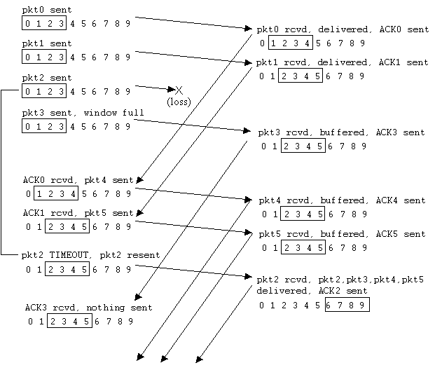
Selective repeat in action

Slide 34
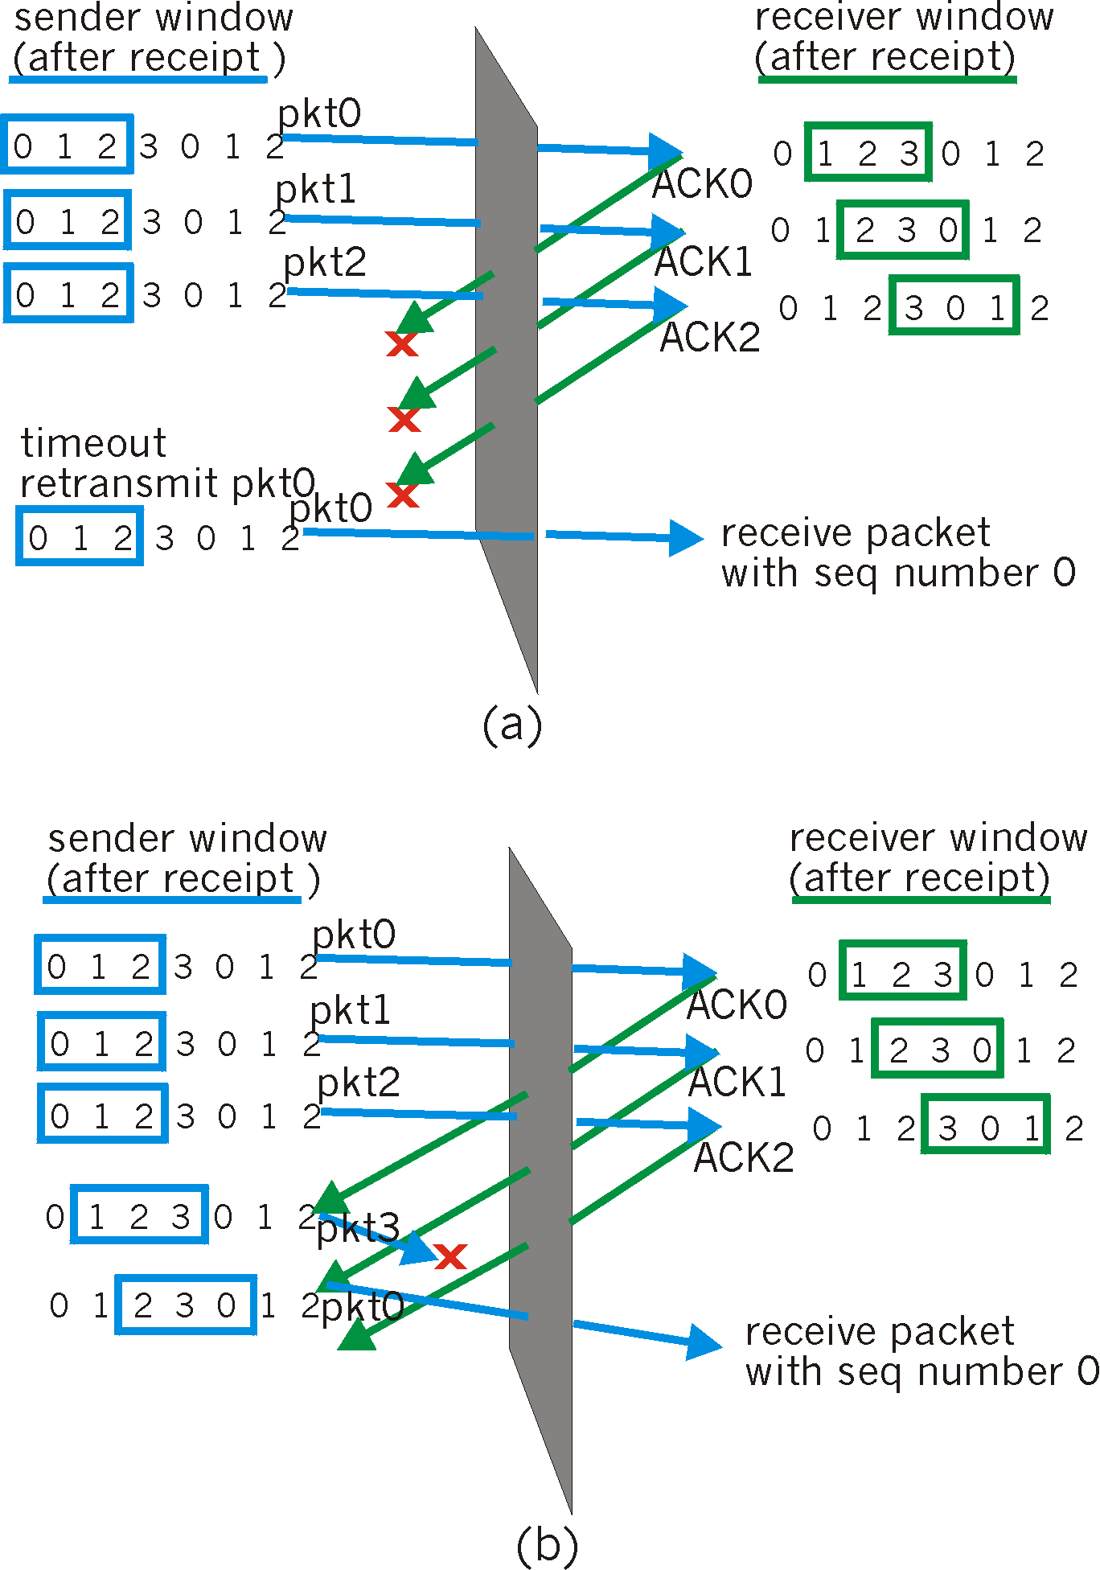
Selective repeat: dilemma
Example:
seq #’s: 0, 1, 2, 3
window size=3
receiver sees no difference in two scenarios!
incorrectly passes duplicate data as new in (a)
Q: what relationship between seq # size and window size?

