Slide 1
Chapter 2: Application layer
2.1 Principles of network applications
2.2 Web and HTTP
2.3 FTP
2.4 Electronic Mail
SMTP, POP3, IMAP
2.5 DNS
2.6 P2P file sharing
2.7 Socket programming with TCP
2.8 Socket programming with UDP
2.9 Building a Web server

Slide 2
DNS
DNS services
hostname to IP address translation
host aliasing
Canonical, alias names
mail server aliasing
load distribution
replicated Web servers: set of IP addresses for one canonical name
Why not centralize DNS?
single point of failure
traffic volume
distant centralized database
maintenance
doesn’t scale!

Slide 3
Distributed, Hierarchical Database
Root DNS Servers
com DNS servers
org DNS servers
edu DNS servers
yahoo.com
DNS servers
pbs.org
DNS servers
poly.edu
DNS servers
umass.edu
DNS servers
amazon.com
DNS servers
Client wants IP for www.amazon.com; 1st approx:
client queries a root server to find com DNS server
client queries com DNS server to get amazon.com DNS server
client queries amazon.com DNS server to get IP address for www.amazon.com

Slide 4
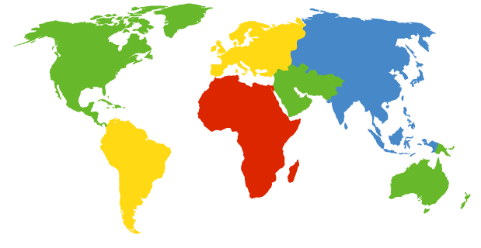
DNS: Root name servers
contacted by local name server that can not resolve name
root name server:
contacts authoritative name server if name mapping not known
gets mapping
returns mapping to local name server
a Verisign, Dulles, VA
c Cogent, Herndon, VA (also LA)
d U Maryland College Park, MD
g US DoD Vienna, VA
h ARL Aberdeen, MD
j Verisign, ( 21 locations)
k RIPE London (also 16 other locations)
i Autonomica, Stockholm (plus 28 other locations)
e NASA Mt View, CA
f Internet Software C. Palo Alto, CA (and 36 other locations)
m WIDE Tokyo (also Seoul, Paris, SF)
13 root name servers worldwide
b USC-ISI Marina del Rey, CA
l ICANN Los Angeles, CA

Slide 5
TLD and Authoritative Servers
Top-level domain (TLD) servers:
responsible for com, org, net, edu, etc, and all top-level country domains uk, fr, ca, jp.
Network Solutions maintains servers for com TLD
Educause for edu TLD
Authoritative DNS servers:
organization’s DNS servers, providing authoritative hostname to IP mappings for organization’s servers (e.g., Web, mail).
can be maintained by organization or service provider

Slide 6
Local Name Server
does not strictly belong to hierarchy
each ISP (residential ISP, company, university) has one.
also called “default name server”
when host makes DNS query, query is sent to its local DNS server
acts as proxy, forwards query into hierarchy

Slide 7
DNS name resolution example
root DNS server
2
Host at cis.poly.edu wants IP address for gaia.cs.umass.edu
3
TLD DNS server
4
5
iterated query:
contacted server replies with name of server to contact
“I don’t know this name, but ask this server”
local DNS server
dns.poly.edu
7
6
1
8
authoritative DNS server
dns.cs.umass.edu
requesting host
cis.poly.edu
gaia.cs.umass.edu

Slide 8
DNS name resolution example
root DNS server
recursive query:
puts burden of name resolution on contacted name server
heavy load?
2
3
7
6
TLD DNS server
local DNS server
dns.poly.edu
5
4
1
8
authoritative DNS server
dns.cs.umass.edu
requesting host
cis.poly.edu
gaia.cs.umass.edu

Slide 9
DNS: caching and updating records
once (any) name server learns mapping, it caches mapping
cache entries timeout (disappear) after some time
TLD servers typically cached in local name servers
Thus root name servers not often visited
update/notify mechanisms under design by IETF
RFC 2136
http://www.ietf.org/html.charters/dnsind-charter.html

Slide 10
DNS records
DNS: distributed db storing resource records (RR)
RR format: (name, value, type, ttl)
Type=A
name is hostname
value is IP address
Type=CNAME
name is alias name for some “canonical” (the real) name
www.ibm.com is really
servereast.backup2.ibm.com
value is canonical name
Type=NS
name is domain (e.g. foo.com)
value is hostname of authoritative name server for this domain
Type=MX
value is name of mailserver associated with name

Slide 11
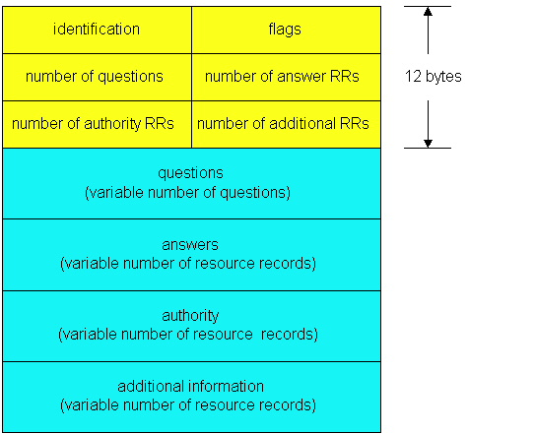
DNS protocol, messages
DNS protocol : query and reply messages, both with same message format
msg header
identification: 16 bit # for query, reply to query uses same #
flags:
query or reply
recursion desired
recursion available
reply is authoritative

Slide 12
DNS protocol, messages
Name, type fields
for a query
RRs in response
to query
records for
authoritative servers
additional “helpful”
info that may be used

Slide 13
nslookup & dig
What is the IP address of db.cs.southern.edu?
What is the MX for southern.edu
How many subdomains does southern.edu have?
nslookup db.cs.southern.edu
Nslookup set type=MX southern.edu
First we have to find the authoritative server: dig southern.edu dig @[ns] southern.edu axfr | grep NS

Slide 14
Chapter 2: Application layer
2.1 Principles of network applications
app architectures
app requirements
2.2 Web and HTTP
2.4 Electronic Mail
SMTP, POP3, IMAP
2.5 DNS
2.6 P2P file sharing
2.7 Socket programming with TCP
2.8 Socket programming with UDP
2.9 Building a Web server

Slide 15
Comparing Client-server, P2P architectures
Notes:
Exponential Bad
Polynomial Tractable
Linear (Polynomial) Good
What is this? Looks Logarithmic and that is GREAT!

Slide 16
P2P Case Study: BitTorrent
P2P file distribution
tracker: tracks peers
participating in torrent
torrent: group of
peers exchanging
chunks of a file
obtain list
of peers
trading
chunks
peer

Slide 17
BitTorrent (1)
file divided into 256KB chunks.
peer joining torrent:
has no chunks, but will accumulate them over time
registers with tracker to get list of peers, connects to subset of peers (“neighbors”)
while downloading, peer uploads chunks to other peers.
peers may come and go
once peer has entire file, it may (selfishly) leave or (altruistically) remain

Slide 18
BitTorrent (2)
Pulling Chunks
at any given time, different peers have different subsets of file chunks
periodically, a peer (Alice) asks each neighbor for list of chunks that they have.
Alice issues requests for her missing chunks
rarest first
Sending Chunks: tit-for-tat
Alice sends chunks to four neighbors currently sending her chunks at the highest rate
re-evaluate top 4 every 10 secs
every 30 secs: randomly select another peer, starts sending chunks
newly chosen peer may join top 4

