Slide 1

The Network Core
mesh of interconnected routers
the fundamental question: how is data transferred through net?
  circuit switching: dedicated circuit per call: telephone net
  packet-switching: data sent thru net in discrete “chunks”

Slide 2
Network Core: Circuit Switching
End-end resources reserved for “call”
link bandwidth, switch capacity
dedicated resources: no sharing
circuit-like (guaranteed) performance
call setup required

Slide 3
Circuit Switching: FDM and TDM
Example:
FDM
4 users
frequency
time
TDM
frequency
time
Notes:
Two simple multiple access control techniques.
Each mobile’s share of the bandwidth is divided into portions for the uplink and the downlink. Also, possibly, out of band signaling.
As we will see, used in AMPS, GSM, IS-54/136

Slide 4
Numerical example
How long does it take to send a file of 640,000 bits from host A to host B over a circuit-switched network?
  All links are 1.536 Mbps
  Each link uses TDM with 24 slots/sec
  500 msec to establish end-to-end circuit
Let’s work it out!
Notes:
What is the frame rate? Well they are assuming a little knowledge here: 24 slots/sec means that we have 24 circuits or 24 slots per frame and 1 frame per second.
1.536 Mb/sec / 24 slots/sec = 64000 kbs or 8000 bytes/sec
So we have 10 seconds + .5 = 10.5 seconds.
What would we get with a packet switched network.

Slide 5
Network Core: Packet Switching
each end-end data stream divided into packets
user A, B packets share network resources
each packet uses full link bandwidth
resources used as needed
resource contention:
aggregate resource demand can exceed amount available
congestion: packets queue, wait for link use
store and forward: packets move one hop at a time
  Node receives complete packet before forwarding
Bandwidth division into “pieces”
Dedicated allocation
Resource reservation

Slide 6
Packet Switching: Statistical Multiplexing
100 Mb/s
Ethernet
A
C
statistical multiplexing
1.5 Mb/s
B
queue of packets
waiting for output
link
D
E
Sequence of A & B packets does not have fixed pattern, bandwidth shared on demand ➔ statistical multiplexing.
TDM: each host gets same slot in revolving TDM frame.

Slide 7
Packet-switching: store-and-forward
L
R
R
R
takes L/R seconds to transmit (push out) packet of L bits on to link at R bps
store and forward: entire packet must arrive at router before it can be transmitted on next link
delay = 3L/R (assuming zero propagation delay)
Example:
L = 7.5 Mbits
R = 1.5 Mbps
transmission delay = 15 sec
more on delay shortly …
Notes:
Start Here Wednesday
FIRST: Drag the qualities of a good network out of them.
L = 7.5, R = 1.5 → L/R = 5 seconds | DO THIS ON THE BOARD AND SHOW THE EXAMPLE OF CANCELING UNITS!!!!

Slide 8
Packet switching versus circuit switching
Packet switching allows more users to use network!
1 Mb/s link
each user:
  100 kb/s when “active”
  active 10% of time
circuit-switching:
  10 users
packet switching:
  with 35 users, probability > 10 active at same time is less than .0004
N users
1 Mbps link
Q: how did we get value 0.0004?

Slide 9
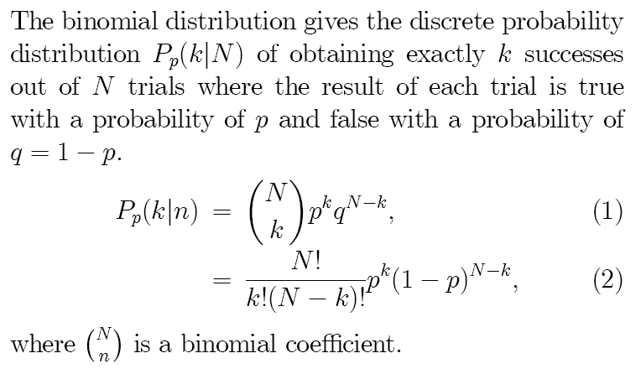
Binomial Distribution
Weisstein, Eric W. "Binomial Distribution." From MathWorld--A Wolfram Web Resource. http://mathworld.wolfram.com/BinomialDistribution.html

Slide 10
Probability Example

Slide 11
Packet switching versus circuit switching
Is packet switching a “slam dunk winner?”
great for bursty data
  resource sharing
  simpler, no call setup
excessive congestion: packet delay and loss
  protocols needed for reliable data transfer, congestion control
Q: How to provide circuit-like behavior?
  bandwidth guarantees needed for audio/video apps
  still an unsolved problem (chapter 7)
Q: human analogies of reserved resources (circuit switching) versus on-demand allocation (packet-switching)?
Notes:
Segue packet switching is what the IP layer does. Routing (also something that happens on the network layer) is something we’ll talk about later.

Slide 12
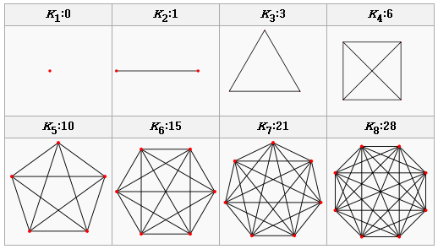
Internet structure: network of networks
Complete graph - Wikipedia, the free encyclopedia
http://en.wikipedia.org/wiki/Complete_graph
Screen clipping taken: 9/4/2007, 10:30 PM
roughly hierarchical
at center: “tier-1” ISPs (e.g., Verizon, Sprint, the New AT&T, Cable and Wireless), national/international coverage
  treat each other as equals
Tier-1 providers interconnect (peer) privately
Tier 1 ISP
Tier 1 ISP
Tier 1 ISP
Notes:
Now that we have some quantitative knowledge under our belts: Let’s look at the topology of the network.
All tier 1 providers connect to every other tier 1 providers.

Slide 13
Tier-1 ISP: e.g., Sprint
POP: point-of-presence
to/from backbone
…
peering
….
…
…
…
to/from customers

Slide 14
Chapter 1: roadmap
  1.1 What is the Internet?
  1.2 Network edge
    end systems, access networks, links
  1.3 Network core
    circuit switching, packet switching, network structure
  1.4 Delay, loss and throughput in packet-switched networks
  1.5 Protocol layers, service models
  1.6 Networks under attack: security
  1.7 History

Slide 15
How do loss and delay occur?
packets queue in router buffers
packet arrival rate to link exceeds output link capacity
packets queue, wait for turn
packet being transmitted (delay)
A
B
packets queueing (delay)
free (available) buffers: arriving packets
dropped (loss) if no free buffers

Slide 16
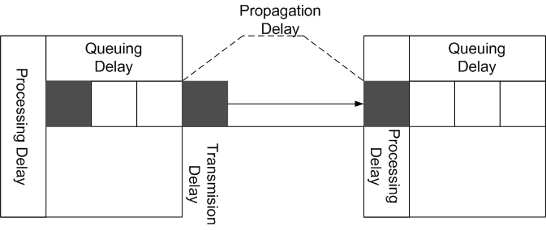
Four sources of packet delay
1. Nodal processing:
  check bit errors
  determine output link
  (forwarding)
  Place in queue
2. Queueing
  time waiting at output link for transmission
  depends on congestion level of router
3. Transmission Delay
  R=link bandwidth (bps)
  L=packet length (bits)
  time to send bits into link = L/R
4. Propagation Delay
  d – distance or length of physical link
  s – speed ~ 2x10⁸ m/s
  Delay_{prop} = d/s
Note: s and R are very different quantities!
Notes:
Transmission Delay vs Propagation delay http://media.pearsoncmg.com/aw/aw_kurose_network_2/applets/transmission/delay.html
Time to process a packet and place it in the queue
The time the packet spends in the queue before transmission
Transmission Time = The time the packet is being transmitted onto the wire
Propagation time = The time for the last bit to move all the way across the wire to the next node

Slide 17
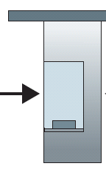
Caravan analogy
100 km
100 km
ten-car
caravan
toll
booth
toll
booth
cars “propagate” at
100 km/hr
toll booth takes 12 sec to service car (transmission time)
car~bit; caravan ~ packet
Q: How long until caravan is lined up before 2nd toll booth?
Time to “push” entire caravan through toll booth onto highway = 12*10 = 120 sec
Time for last car to propagate from 1st to 2nd toll both: 100km/(100km/hr)= 1 hr
A: 62 minutes

Slide 18
Caravan analogy (more)
100 km
100 km
ten-car
caravan
toll
booth
toll
booth
Yes! After 7 min, 1st car at 2nd booth and 3 cars still at 1st booth.
1st bit of packet can arrive at 2nd router before packet is fully transmitted at 1st router!
  See Ethernet applet at AWL Web site
Cars now “propagate” at
1000 km/hr
Toll booth now takes 1 min to service a car
Q: Will cars arrive to 2nd booth before all cars serviced at 1st booth?
Notes:
Delay = 1 minute
Prop = 6 minutes

Slide 19
Nodal delay
d_{proc} = processing delay
  typically a few microsecs or less
d_{queue} = queuing delay
  depends on congestion
d_{trans} = transmission delay
  = L/R, significant for low-speed links
d_{prop} = propagation delay
  a few microsecs to hundreds of msecs

Slide 20
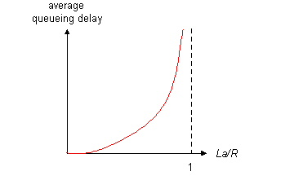
Queueing delay (revisited)
R=link bandwidth (bps)
L=packet length (bits)
a=average packet arrival rate
traffic intensity = La/R
La/R ~ 0: average queueing delay small
La/R -> 1: delays become large
La/R > 1: more “work” arriving than can be serviced, average delay infinite!

Slide 21
“Real” Internet delays and routes
What do “real” Internet delay & loss look like?
Traceroute program: provides delay measurement from source to router along end-end Internet path towards destination. For all i:
  sends three packets that will reach router i on path towards destination
  router i will return packets to sender
  sender times interval between transmission and reply.
3 probes
3 probes
3 probes

Slide 22
“Real” Internet delays and routes
traceroute: gaia.cs.umass.edu to www.eurecom.fr
Three delay measurements from
gaia.cs.umass.edu to cs-gw.cs.umass.edu
1 cs-gw (128.119.240.254) 1 ms 1 ms 2 ms
2 border1-rt-fa5-1-0.gw.umass.edu (128.119.3.145) 1 ms 1 ms 2 ms
3 cht-vbns.gw.umass.edu (128.119.3.130) 6 ms 5 ms 5 ms
4 jn1-at1-0-0-19.wor.vbns.net (204.147.132.129) 16 ms 11 ms 13 ms
5 jn1-so7-0-0-0.wae.vbns.net (204.147.136.136) 21 ms 18 ms 18 ms
6 abilene-vbns.abilene.ucaid.edu (198.32.11.9) 22 ms 18 ms 22 ms
7 nycm-wash.abilene.ucaid.edu (198.32.8.46) 22 ms 22 ms 22 ms
8 62.40.103.253 (62.40.103.253) 104 ms 109 ms 106 ms
9 de2-1.de1.de.geant.net (62.40.96.129) 109 ms 102 ms 104 ms
10 de.fr1.fr.geant.net (62.40.96.50) 113 ms 121 ms 114 ms
11 renater-gw.fr1.fr.geant.net (62.40.103.54) 112 ms 114 ms 112 ms
12 nio-n2.cssi.renater.fr (193.51.206.13) 111 ms 114 ms 116 ms
13 nice.cssi.renater.fr (195.220.98.102) 123 ms 125 ms 124 ms
14 r3t2-nice.cssi.renater.fr (195.220.98.110) 126 ms 126 ms 124 ms
15 eurecom-valbonne.r3t2.ft.net (193.48.50.54) 135 ms 128 ms 133 ms
16 194.214.211.25 (194.214.211.25) 126 ms 128 ms 126 ms
17 * * *
18 * * *
19 fantasia.eurecom.fr (193.55.113.142) 132 ms 128 ms 136 ms
trans-oceanic
link
* means no response (probe lost, router not replying)

Slide 23
Packet loss
queue (aka buffer) preceding link in buffer has finite capacity
packet arriving to full queue dropped (aka lost)
lost packet may be retransmitted by previous node, by source end system, or not at all
buffer
(waiting area)
packet being transmitted
A
B
packet arriving to
full buffer is lost

Slide 24
Throughput
throughput: rate (bits/time unit) at which bits transferred between sender/receiver
  instantaneous: rate at given point in time
  average: rate over long(er) period of time
link capacity
R_{s} bits/sec
link capacity
R_{c} bits/sec
server, with
file of F bits
to send to client
pipe that can carry
fluid at rate
R_{s} bits/sec)
pipe that can carry
fluid at rate
R_{c} bits/sec)
server sends bits
(fluid) into pipe

Slide 25
Throughput (more)
R_{s} < R_{c} What is average end-end throughput?
R_{s} bits/sec
R_{c} bits/sec
R_{s} > R_{c} What is average end-end throughput?
R_{s} bits/sec
R_{c} bits/sec
bottleneck link
link on end-end path that constrains end-end throughput

Slide 26
Throughput: Internet scenario
R_{s}
per-connection end-end throughput: min(R_{c},R_{s},R/10)
in practice: R_{c} or R_{s} is often bottleneck
R_{s}
R_{s}
R
R_{c}
R_{c}
R_{c}
10 connections (fairly) share backbone bottleneck link R bits/sec

